Slide 1

Agenda:
Biblical Word Study
Psychological Disorders (Chapter 15)

Slide 2
Biblical Word Study
Anxiety/Worry – i.e., Matthew 6:25 (NIV) - ²⁵"Therefore I tell you, do not worry (be anxious) about your life, what you will eat or drink; or about your body, what you will wear. Is not life more important than food, and the body more important than clothes?”
Gr. Μεριμναω (Merimnau) – to be anxious, or solicitous (uneasy, bothered, apprehensive); to expend careful thought; to concern one’s self; to have the thoughts occupied with

Slide 3
Biblical Word Study
Evil – i.e., 1 Thessalonians 5:21-22 (NIV) ²¹Test everything. Hold on to the good. ²²Avoid every kind of evil.
Gr. Πονηροs (Poneros) – bad (terrible, dreadful, shocking, ruthless), unsound; evil (hateful), afflictive; wrongful, malignant (nasty, cruel), malevolent; wicked(ness) (depraved, immoral, atrocious, appalling), impious; slothful, inactive; the evil one, the devil; can also imply covetousness

Slide 4
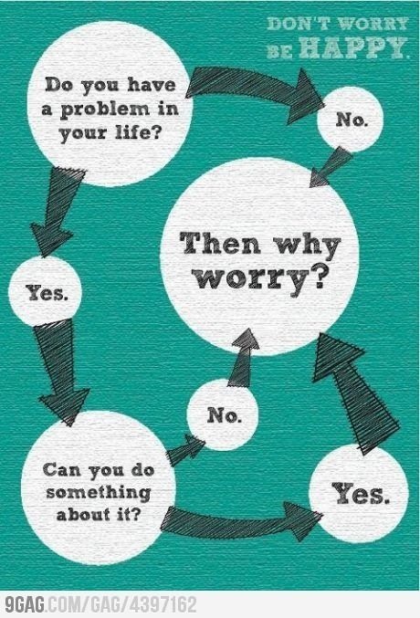
Psychological Disorders

Slide 5
True or False?
T F 1. In some cultures, depression and schizophrenia are nonexistent.
T F 2. Many people are curious about the cause of mental disorders.
T F 3. About 30 percent of psychologically disordered people are dangerous; that is, they are more likely than other people to commit a crime.
T F 4. Research indicates that in the United States there are more prison inmates with severe mental disorders than there are psychiatric inpatients in all the country’s hospitals.
T F 5. Identical twins who have been raised separately sometimes develop the same phobias.

Slide 6
True or False?
T F 6. Dissociative identity disorder is a type of schizophrenia.
T F 7. In North America, today’s young adults are three times as likely as their grandparents to report having experienced depression.
T F 8. White Americans commit suicide nearly twice as often as Black Americans do.
T F 9. There is strong evidence for a genetic predisposition to schizophrenia.
T F 10. About 1 in 4 adult Americans suffer from a diagnosable mental disorder in a given year.

Slide 7

An Introduction to Psychological Science
Third Canadian Edition
Chapter 15
Psychological Disorders
Slide in this Presentation Contain Hyperlinks. JAWS users should be able to get a list of links by using INSERT+F7
Copyright © 2021 Pearson Canada, Inc.
Notes:
If this PowerPoint presentation contains mathematical equations, you may need to check that your computer has the following installed:
1) MathType Plugin
2) Math Player (free versions available)
3) NVDA Reader (free versions available)

Slide 8

Modules
15.1: Defining and Classifying Psychological Disorders
15.2: Personality and Dissociative Disorders
15.3: Anxiety, Obsessive-Compulsive, and Depressive Disorders
15.4: Schizophrenia
MPI/Archive Photos/Getty Images

Slide 9
15.1 Learning Objectives
Know the key terminology associated with defining and classifying psychological disorders.
Understand advantages and criticisms associated with the Diagnostic and Statistical Manual of Mental Disorders (DSM-5).
Apply your knowledge of the mental disorders defence to decide if defendants are criminally responsible for their actions.
Analyze whether the benefits of labelling psychological disorders outweigh the disadvantages.
Notes:
Know the key terminology associated with defining and classifying psychological disorders.
See the bold, italicized terms below.
Understand advantages and criticisms associated with the Diagnostic and Statistical Manual of Mental Disorders (DSM-5).
Using the DSM-5 ensures that all psychologists and psychiatrists are using the same criteria to define different psychological disorders; this improves the reliability and consistency of psychological diagnoses. However, the DSM-5 has faced many criticisms. First, psychologists need to decide if a symptom is severe enough to warrant treatment. Second, the number of symptoms that must be present before a disorder is diagnosed seems somewhat arbitrary. Third, although the large number of possible disorders may make it easier for mental health workers to make a diagnosis, it may also lead to unnecessary diagnoses. Finally, there is currently a need for more biological or genetic markers to be added to the diagnostic criteria for many disorders.
Apply your knowledge of the mental disorders defence to decide if defendants are criminally responsible for their actions.
The legal consideration of “sanity” hinges on whether a person who commits a crime understands that their actions are wrong in a legal or a moral sense. Students should be able to use what they’ve learned read about criminal responsibility and the mental disorders defence to judge real-world cases: guilty or not guilty?
Analyze whether the benefits of labeling psychological disorders outweigh the disadvantages.
To evaluate the importance of the DSM-IV’s labels, it would be helpful to consider their functions. They organize large amounts of information—about symptoms, causes, and outcomes—into terminology that mental health professionals can work with. From a practical point of view, this system meets the requirements of the insurance companies that pay for psychological services. One downside of this process is that once the label is applied, people have the tendency to misinterpret behaviours that are perfectly normal.

Slide 10
Defining Abnormal Behaviour
Abnormal psychology (p. 564)
What is “abnormal” behaviour?
Maladaptive behaviour (p. 564)
Notes:
Abnormal psychology (p. 564) is the psychological study of mental illness.
1) Given the immense range of apparently normal human behaviour and experience, how can we determine what is abnormal? It’s useful to note the difference between abnormal and unusual.
i) A person who cuts or burns themselves until serious injury is sustained is behaving abnormally.
ii) Someone who graduates college before the age of 20 is unusual but may show no signs of mental illness.
a) The difference between the two and the key criterion used by psychologists in deciding whether a person has a disorder is whether the person’s
thoughts, feelings, or behaviours are maladaptive.
Maladaptive behaviour (p. 564) causes distress to oneself or others, impairs day-to-day functioning, or increases the risk of injury or harm
to oneself or others.
iii) There are many exceptions to this guideline. Some behaviours fulfill these criteria but do not necessarily indicate mental illness. The criteria for determining whether a given behaviour should be viewed as a disorder are not perfect and cannot account for all circumstances. But, generally speaking, when a person’s behaviour and experience starts to become significantly dysfunctional, there may be cause for concern.

Slide 11
Early Understanding and Treatment
Possession by evil
Asylums (p. 564)
William Battie
Phillippe Pinel
Notes:
1) Centuries ago, “treatments" for mental illness were directly based on the possession by evil model of illness. Brutal imprisonment, torture, and demon exorcism were not exactly designed with human psychology in mind, as ways of rehabilitating dysfunctional thoughts, emotions and behaviours. The focus was on driving the demon out of the person's body, or simply executing them, as in the witch hunting craze which saw the execution of tens of thousands of innocent people (almost all of whom were women).
2) It is important to point out that brutal “treatments” were the exception rather than the rule. Instead, most people with psychological disorders were taken care of by their family. Only in extreme cases were individuals placed in the limited number of asylums, which were essentially storage facilities for patients.
Asylums (p. 564) were residential facilities for the mentally ill.
3) In 1751, the director of St. Luke’s Hospital in London (U.K.), William Battie, began to write about the potential therapeutic benefits of being treated by asylum physicians and staff. Battie’s work, along with important contributions from Philippe Pinel, a physician in France (see Module 16.1), led to the birth of modern psychiatry.

Slide 12
Early Classification Systems
Mania, Melancholia
Medical model (p. 564)
Emil Kraepelin
Notes:
1) At the beginning of the 1800s, most mental illnesses were classified as being mania (which included symptoms such as hallucinations and excessive energy) and melancholia
(which included depression and anxiety).
i) The physicians treating these cases in asylums also had to treat patients suffering from what we would now call neurological disorders (e.g. dementia). Given that physicians often treated both psychiatric and neurological cases, it is not surprising that most mental illnesses were diagnosed in the same way as physical illnesses.
2) Psychiatry at this time adopted the medical model.
Medical model (p. 564) sees psychological conditions through the same lens as Western medicine tends to see physical conditions—as sets of symptoms, causes, and outcomes, with treatments aimed at changing physiological processes in order to alleviate symptoms.
i) Just like medical conditions (e.g., diabetes, cancer, etc.), psychological disorders have symptoms, probable causes, and likely outcomes.
a) They also are analogous in terms of preventative measures, interventions, and treatments.
2) In the late 1800s, Emil Kraepelin was a German psychiatrist who spent time studying behaviour with Wilhelm Wundt, director of the world’s first psychology laboratory in Leipzig.
i) While working in an asylum, Kraepelin created data cards for each of the patients under his care in order to track how the patients’ mental illnesses progressed over time. By testing large numbers of individuals, he was able to see which symptoms seemed to occur together (e.g., depression and anxiety). He was also able to tell which disorders were curable and which ones were more likely to get worse over time.
ii) Through careful observation, Kraepelin was able to distinguish between two prominent disorders – what we now call bipolar disorder and schizophrenia – that are still treated by healthcare workers today.
iii) Kraepelin’s work highlighted the need for people researching or treating mental disorders to have a common set of terminology. To address this concern, the American Psychiatric Association published a Statistical Manual for the Use of Institutions for the Insane. This short publication provided basic descriptions of common psychological disorders. Although the book was revised a number of times, it had one major problem: only about 10% of clinical cases in hospitals matched its descriptions!

Slide 13
Psychology’s Puzzle: How to Diagnose Psychological Disorders (1 of 2)
Diagnostic and Statistical Manual for Mental Disorders (D S M) (p. 565)
First edition (D S M-I)
Imperfect document
Fifth edition (D S M-5)
Work in progress
Notes:
1) During World War II, American psychiatrists were hired in large numbers by the U.S. military to aid in the selection of soldiers and to treat mental disturbances resulting from military duty. This led to the creation of a classification scheme that allowed the psychiatrists to identify the different mental disturbances experienced by soldiers. Building on the military’s diagnostic system, as well as the sixth edition of the World Health Organization’s International Statistical Classification of Disease (which included mental disorders), the American Psychiatric Association created the Diagnostic and Statistical Manual of Mental Disorders (DSM).
Diagnostic and Statistical Manual for Mental Disorders (DSM) (p. 565) is a standardized manual to aid in the diagnosis of disorders.
2) The first edition of the DSM (DSM-I) described the symptoms of 106 different mental disorders. However, some of these disorders reflected the cultural biases of that era. For instance, homosexuality was listed as a psychological disorder (and remained one until 1980).
i) DSM-I was an imperfect document. It has been revised several times since its original publication. With each revision, the number of psychological disorders has increased, sometimes dramatically (see Figure 15.1).
3) The current version of the DSM is the DSM-5, released in May 2013.
i) The DSM-5 divides mental illnesses up into 19 categories, each containing several subtypes. For example, one section of the DSM-5 discusses different aspects of depression, another covers anxiety disorders, and another covers schizophrenia.
ii) Although each subtype of each disorder is associated with a number of symptoms, there is a subtle difference in how psychological disorders are discussed in the DSM-5. More attention is now paid to how the severity of disorders can exist along a dimension from relatively mild to very debilitating.
a) Treating some disorders in a dimensional fashion (i.e., mild to severe) has had some interesting consequences for patients. For example, Asperger’s syndrome is sometimes treated as a less severe form of autism, a developmental disorder associated with poor social skills and that may be accompanied by intellectual impairments. In the DSM-5, Asperger’s has disappeared. Individuals who were once diagnosed with this disorder are either considered mildly autistic or no longer have an illness.
iii) The DSM-5 is not intended to be the final version of this diagnostic tool. Its designers assumed that revisions would be published as brain imaging and genetic research shed additional light on mental illnesses.

Slide 14
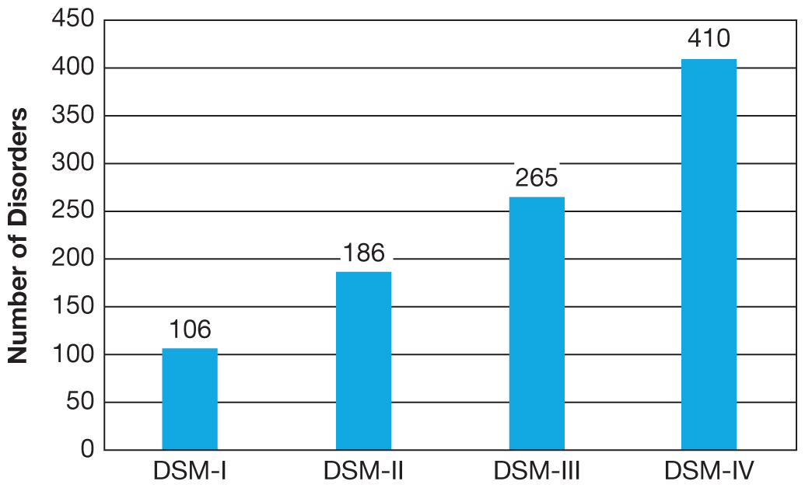
Psychology’s Puzzle: How to Diagnose Psychological Disorders (2 of 2)
Figure 15.1 The Number of Disorders in the D S M over Time
The number of behaviours that are classified as psychological disorders has changed over the past 80 years. The numbers increased substantially from the DSM-I through the DSM-4.
Notes:
3) The current version of the DSM is the DSM-5, released in May 2013.
i) The DSM-5 divides mental illnesses up into 19 categories, each containing several subtypes. For example, one section of the DSM-5 discusses different aspects of depression, another covers anxiety disorders, and another covers schizophrenia.
ii) Although each subtype of each disorder is associated with a number of symptoms, there is a subtle difference in how psychological disorders are discussed in the DSM-5. More attention is now paid to how the severity of disorders can exist along a dimension from relatively mild to very debilitating.
a) Treating some disorders in a dimensional fashion (i.e., mild to severe) has had some interesting consequences for patients. For example, Asperger’s syndrome is sometimes treated as a less severe form of autism, a developmental disorder associated with poor social skills and that may be accompanied by intellectual impairments. In the DSM-5, Asperger’s has disappeared. Individuals who were once diagnosed with this disorder are either considered mildly autistic or no longer have an illness.
iii) The DSM-5 is not intended to be the final version of this diagnostic tool. Its designers assumed that revisions would be published as brain imaging and genetic research shed additional light on mental illnesses.
Long Description:
The x-axis shows DSM I, II, III, and IV. The y-axis shows number of disorders from 0 to 450 in increments of 50. The details of the graph are as follows:
DSM-I: 106
DSM-II: 186
DSM-III: 265
DSM-IV: 410

Slide 15
Critiquing the D S M & The Power of a Diagnosis
D S M is imprecise
“Symptom” or normal experience?
Disorders share symptoms
“Disorder” or not?
Diagnostic labels
Possible drawbacks
Notes:
1) Psychologists and psychiatrists don’t have precise tools. Instead, the diagnostic process is subjective, involving human clinicians trying to make sense of the different behaviours being displayed by their clients. To try to help clinicians, the DSM offers lists of specific symptoms that are indicative of specific disorders.
i) Unfortunately, this doesn’t entirely solve the problem for many reasons.
a) For one, a clinician still has to subjectively decide whether a client displays each symptom and whether it is severe enough to be considered a symptom or just normal experience.
b) Another problem is that different disorders often share many common symptoms. As a result, different mental health professionals might make different diagnoses. c) An additional weakness of the DSM is that there is a fine, and essentially arbitrary, line between whether a person is considered to have a disorder or not. If a person seems to have the necessary number of symptoms (e.g., five out of a possible nine), then they have the disorder, but with one symptom less, they don’t.
2) What are the outcomes of diagnosing a person as having a particular disorder?
i) On the positive side, it is hoped that receiving a diagnosis should make people more likely to seek and receive effective treatment.
ii) However, diagnostic labels can also have their drawbacks.
a) One concern related to psychological diagnoses is that once a person has been labelled as having a disorder, the label itself may change how that person is viewed by others, and how subsequent behaviours are interpreted.
b) A related problem is that seeing oneself as mentally ill can be associated with low self-esteem or feelings of helplessness. In some cases, a diagnosis may lead a person to indulge in even more extreme or destructive behaviour patterns. Because of stigma and negative attitudes toward the mentally ill, people may expect that other people will reject and devalue them. This perception may lead them to withdraw from social contact and fail to seek the support that could help them.
c) We should be very concerned about using diagnostic labels accurately.

Slide 16
Working the Scientific Literacy Model: Culture and Diagnosing Mental Disorders (1 of 2)
What do we know about culture and diagnosing mental disorders?
Culture-bound syndromes (p. 568)
Ataque de nervios
Shenjing shuairuo
How can science explain the effect of culture on diagnosing mental disorders?
Notes:
1) What do we know about culture and diagnosing mental disorders?
i) Throughout much of psychology’s history, the discussion of culture and mental illness often turned to culture-bound syndromes (p. 568), expressions of distress that are recognized across a given culture but that tend not to appear outside of that culture.
a) One such syndrome is known as ataque de nervios. This disorder, which can occur in Latin American cultures, involves trembling, uncontrollable crying and/or shouting, fainting episodes, and, in some cases, aggressive behaviour.
b) Another example is neurasthenia or shenjing shuairuo, a relatively common Mandarin Chinese ailment in which a person experiences extreme fatigue, physical weakness, pain, and problems with relaxation after periods of mental effort.
c) Although illnesses such as ataque de nervios and neurasthenia were both included in the DSM-IV, they were often viewed as interesting windows into a foreign culture rather than useful information that could affect how North Americans of Latino or Chinese heritage could be treated. In other words, culture was often viewed as something that influenced disorders that occurred “over there” rather than disorders that occur “here.”
2) How can science explain the effect of culture on diagnosing mental disorders?
i) A number of studies have found that the rates of common disorders like anxiety, depression, and schizophrenia differ across cultures.
a) For example, the rates of anxiety disorders (discussed in Module 15.3) can vary by up to three times depending upon where one lives.
b) We also know that when people immigrate to a new country like Canada or the United States, the rates of psychological disorders are lower if they move into neighbourhoods that have larger number of people from their country of origin.
ii) Given that the human genome does not differ much across the globe, it is safe to conclude that these differences are due to culture, or to an interaction between culture and biological variables.
iii) There are also cultural differences in the willingness to seek help for disorders, which can influence how open a patient will be with a clinician and thus the accuracy of the resulting diagnosis.

Slide 17
Working the Scientific Literacy Model: Culture and Diagnosing Mental Disorders (2 of 2)
Can we critically evaluate this information?
Cultural Formulation Interview
Why is this relevant?
Improving accuracy of diagnosis
Notes:
1) Can we critically evaluate this information?
i) An obvious question that arises from these cross-cultural studies is “If cultural information is important, can it actually be used to improve the accuracy of diagnoses?”
a) In order to test this possibility, the DSM-5 now includes the Cultural Formulation Interview, a supplement aimed at helping clinicians collect additional information about cultural factors that could influence diagnoses. The rationale for this interview was that increasing awareness of a patient’s cultural context, including the stresses of immigration (if applicable), would lead to more efficient and effective treatments for people seeking help.
b) The initial results of studies using the Cultural Formulation Interview appear positive. Research has shown that this interview can improve the accuracy of diagnoses such as schizophrenia and can improve overall clinical outcomes of non-Caucasian patients.
ii) An additional question that could emerge from this research is how can culture influence the rates of different disorders? What is the mechanism involved? The most likely explanation involves epigenetics and the expression of different genes (see Module 3.1). Different geographical locations will have different climates, pollution levels, violence, poverty, and stress levels. All of these factors can influence whether or not a gene is expressed.
2) Why is this relevant?
i) Understanding how culture influences the development and appearance of various psychological disorders will improve the accuracy of diagnoses. The inclusion of a Cultural Formulation Interview into some diagnoses is a very positive step forward, particularly given the dramatic increases in immigration and migration that the world is currently experiencing.

Slide 18
Psychological Diagnoses in the Classroom: A D H D
Attention-deficit hyperactivity disorder (A D H D) (p. 569)
Over-diagnosed?
Notes:
1) Classroom behaviour is one area that presents diagnostic challenges for psychologists and the educators they are helping. Many children are now diagnosed with attention- deficit hyperactivity disorder (ADHD) (p. 569), a developmental disorder in which children show inappropriate levels of hyper-activity and impulsivity while also having problems maintaining their attention to people or activities.
2) Children with ADHD tend to be fidgety in class, talk quickly and excessively, and fail to listen to teachers or peers when spoken to. These children can cause disruptions that not only reduce their own learning but can alter the learning environment for the other students as well. The challenge for educators and psychologists is to identify these children so that they can receive some form of treatment.
i) The DSM-5 states that an individual must have a minimum of six symptoms of inattention or six symptoms of hyperactivity/impulsivity in order to receive a diagnosis of ADHD. The goal is to select the children who have enough symptoms that they have become problematic for the individual while also avoiding diagnosing people who only display a few disruptive behaviours.
ii) If the psychologists are successful, it can mean that students will gain access to behavioural therapies shown to help with impulsivity and inattention and that can improve the students’ educational outcomes. It might also lead to pharmaceutical treatments that can target the frontal lobe and its connections with dopamine-releasing brain areas in the basal ganglia.
iii) However, some critics have noted that since ADHD was added to the DSM-III in 1980, diagnoses have sky-rocketed, although primarily in North America. Critics also charge that many children are being medicated for disruptive activity that is still within the normal range of childhood behaviour.
iv) There is no definitive answer to this issue. On the one hand, an accurate diagnosis can allow a hyperactive child to receive a relatively normal education. On the other hand, some children may be misdiagnosed (i.e., a false alarm) and could end up being unnecessarily medicated.

Slide 19
Psychological Diagnoses in the Courtroom: The Mental Disorder Defence
Mental disorder defence (p. 570)
Used in less than 1% of Canadian court cases; success rate of less than 25%
M’Naghten rule
Notes:
1) In Canada, the insanity defence is now referred to as the mental disorder defence.
Mental Disorder Defence (p. 570) does not deny that the person committed the offence but claims that the defendant was in such an extreme, abnormal state of mind when committing the crime that he or she could not discern that the actions were legally or morally wrong.
i) This defence is used in less than 1% of cases in Canadian courts and it has a success rate of less than 25%.
2) The insanity defense originated in Great Britain in 1843.
i) Daniel M’Naghten killed the Prime Minister’s secretary, but the jury did not send him to jail because they believed he did not know what he did was wrong.
ii) Instead, he was committed to a mental institution.
iii) The plea “not guilty by reason of insanity” is now known as the M’Naghten rule.
3) Consider two well-known Canadian examples of the mental disorder defence.
i) In 2006, in Barrie, Ontario, Elaine Campione drowned both of her daughters in a bathtub. At the time, she was involved in a custody battle with her ex-husband. Elaine had been diagnosed with a variety of psychological disorders and suffered delusions including that others were trying to steal her children. Her lawyer argued that she was not criminally responsible for her actions, but the Crown countered that even though she was mentally ill, her particular disorders did not prevent her from knowing right from wrong. She was convicted of first-degree murder.
ii) In Edmonton, Alberta in 2013, Nerlin Sarmiento drowned her seven-year-old son in a bathtub. Her lawyer argued that she was so deeply overwhelmed by a major depressive episode that was part of her bipolar disorder that she had become convinced that she was actually rescuing her son from a life of poverty and suffering and believed that killing him was an act of mercy and kindness. In this case, the courts decided that Nerlin was not criminally responsible for her son’s death and required her to receive psychiatric treatment rather than going to jail.

Slide 20
15.2 Learning Objectives
Know the key terminology associated with personality and dissociative disorders.
Understand how different types of personality disorders can affect interpersonal relationships.
Apply your knowledge of antisocial personality disorder to identify which maladaptive behaviour is consistent with each disorder.
Analyze the status of dissociative identity disorder as a legitimate diagnosis.
Notes:
Know the key terminology associated with personality and dissociative disorders.
See the bold, italicized terms below.
Understand how different types of personality disorders can affect interpersonal relationships.
Many personality disorders have negative effects on interpersonal relationships. The Cluster A disorders (paranoid, schizoid, and schizotypal) generally involve unusual ways of interpreting social situations. This can lead to difficulties in accurately communicating with other people. Cluster B disorders (borderline, histrionic, narcissistic, and antisocial) often involve emotional intensity. These disorders often lead to explosive relationships, with fighting and drama. Cluster C disorders (avoidant, dependent, and obsessive- compulsive) hamper relationships because people with these disorders are quite anxious and attempt to find ways to control relationship (by being clingy or demanding, or by avoiding them altogether). In each case, you can see how personality disorders lead to social difficulties.
Apply your knowledge of antisocial personality disorder to identify which maladaptive behaviour is consistent with each disorder.
Students should be able to complete the Apply Activity on page 581 to match the disorder to the behaviour .
Analyze the status of dissociative identity disorder (DID) as a legitimate diagnosis.
The lack of a physical basis for the disorder and its unusual rate and patterns of diagnosis rightly bring about skepticism. For example, diagnoses of DID increased dramatically after a film depicted a purported case of DID. Ensure that your evaluation (of any condition, not just DID) is not biased by fictional or sensationalized accounts you have seen or read. However, it is also important to remember that many of the mental disorders for which we have a greater understanding were at one time considered mysterious and controversial.

Slide 21
Activity: Acting out a Disorder
Your group will receive one of the ten disorders outlined in your notes. You will have 25 minutes to put together a short 5 minute skit that demonstrates the main features of the disorder. You have creative freedom in how you want to put this skit together, however everyone in the group must play a part.
After all the skits are done we’ll take a vote as to who had the best skit, the team with the most votes will receive 2 bonus marks that will be applied to their next quiz.

Slide 22
Defining and Classifying Personality Disorders (1 of 2)
Cluster A Disorders
Odd or eccentric behaviour
Paranoid Personality Disorder, Schizoid Personality Disorder, and Schizotypal Personality Disorder
Cluster B Disorders
Dramatic, emotional, and erratic behaviour
Antisocial Personality Disorder, Borderline Personality Disorder, Histrionic Personality Disorder, and Narcissistic Personality Disorder
Notes:
1) The DSM-5 provides 10 different categories of personality disorders, as shown in Table 15.1. Note that these different disorders share some over-arching factors, resulting in three clusters of somewhat related disorders. The clusters involve (1) odd or eccentric behaviour; (2) dramatic, emotional, and erratic behaviour; and (3) anxious, fearful, and inhibited behaviour.
Personality disorders (p. 572) are particularly unusual patterns of behaviour (relative to one’s cultural context) that are maladaptive, distressing to oneself or others, and resistant to change.

Slide 23
Defining and Classifying Personality Disorders (2 of 2)
Cluster C Disorders
Anxious, fearful, and inhibited behaviour
Avoidant Personality Disorder, Dependent Personality Disorder, and Obsessive-Compulsive Personality Disorder
Personality Disorder Not Otherwise Specified
A diagnosis given to individuals who exhibit patterns of behaviour consistent with that of a personality disorder, but which does not fit into any of the personality disorder categories described above

Slide 24
Paranoid Personality
Paranoid personality disorder (P D P) (p. 573)
Difficulty forming close relationships
2-4% of the population
Threat vigilance
Notes:
Paranoid personality disorder (PDP) (p. 573): individuals are consistently preoccupied by the belief that other people are attempting to harm or deceive them; they often react with anger to these imagined social or physical threats.
1) People with PDP are suspicious of others even when there is no justification for these suspicions.
i) Distorted perceptions of other people’s intentions mean that people with PDP have a difficult time forming close relationships. This tendency can form a vicious circle of repeated negative social interactions and negative thought processes.
ii) The DSM-5 indicates that approximately 2% to 4% of the population has some form of PDP, although little is known about the genes involved with this disorder.
iii) From a biological standpoint, neuroimaging studies have found that people with PDP show faster neural responses to auditory stimuli than a matched control group. They also have larger levels of stress hormones in their cerebrospinal fluid, the liquid substance found in the ventricles and sinuses of the brain. These findings both show that PDP is associated with vigilance for threats, whether they are real or imagined.

Slide 25
Schizoid Personality
Schizoid personality disorder (S P D) (p. 573-574)
Cold and aloof
Less intense emotional expressions
Indifferent to praise or criticism
Notes:
Schizoid personality disorder (SPD) (p. 573-574): an individual is socially detached; he or she does not desire close relationships, including being part of a family, and takes little pleasure in most activities.
1) Individuals with this personality disorder tend to appear cold and aloof. They do not express many emotions and, when they do, these expressions are less intense than is normal. They often appear indifferent to praise or criticism from others. Many people with SPD feel so distant from people that they wonder if other people notice them at all.

Slide 26
Schizotypal Personality
Schizotypal personality disorder (p. 574)
Suspicious and superstitious
Imagined connections between thoughts and events
Associations
Superior temporal gyrus
COMT gene
Pregnancy complications
Psychological trauma and chronic stress
Notes:
Schizoid personality disorder (p. 574): consists of both a discomfort with close relationships as well as unusual or eccentric thoughts and behaviours.
1) Individuals with this personality disorder tend to be suspicious and superstitious. They frequently get lost in their own thoughts and imagine connections between thoughts and events that do not really exist. People with this illness also tend to express their thoughts using abstract and strangely formed sentences.
i) There are a number of brain areas that could be involved. It is possible that the strange manner of speaking found in many people with schizotypal personality disorder is associated with the smaller size of the superior temporal gyrus.
ii) At the genetic level, one form of the COMT gene, which is related to the neurotransmitters dopamine and epinephrine, makes someone more likely to develop SPD. Problems during pregnancy—particularly exposure to the flu virus during week 23 of prenatal development—has also been associated with later schizotypal development in males. Psychological trauma and chronic stress have also been linked with this disorder.

Slide 27
Borderline Personality
Borderline personality disorder (B P D) (p. 575)
All-or-nothing thinking
Troubled relationships
Self-injury
Notes:
Borderline personality disorder (BPD) (p. 575) is characterized by intense extremes between positive and negative emotions, an unstable sense of self, impulsivity, and difficult social relationships.
1) Each of the characteristics of BPD seems to be connected to a tendency to think in all-or-none terms.
i) For example, a person with BPD may fall in love quickly, professing deep commitment and affection, but just as quickly become disgusted by someone’s imperfections.
a) Friends, family, colleagues, and public figures can also be idealized and despised in the same way.
ii) People with BPD may have a hard time understanding that there are bound to be conflicts in any relationship.
2) As a part of their troubled relationships, people with BPD can become paranoid, suspecting that everyone else has similarly unpredictable feelings.
i) Fear of abandonment can lead to risky sexual behaviours in an attempt to form relationships.
3) One key feature of BPD is the tendency toward self-injury, which may involve cutting or burning.
i) These episodes of self-injury may appear to be suicide attempts and in some cases are actual attempts.

Slide 28
Narcissistic Personality
Narcissistic personality disorder (N P D) (p. 575)
Manipulative
Lack empathy
Cheating
Notes:
Narcissistic personality disorder (NPD) (p. 575) is characterized by an inflated sense of self-importance and an intense need for attention and admiration, as well as intense self-doubt and fear of abandonment.
1) In fact, people with NPD are known to manipulate and arrange their relationships to make sure their own needs are met, no matter the toll it takes on others.
i) They often lack empathy.
ii) Their sense of entitlement and specialness allows them to cheat without feeling any guilt or remorse.

Slide 29
Histrionic Personality
Histrionic personality disorder (H P D) (p. 575)
Term has Latin origin
“like an actor”
Use flirtation and flattery
Indulgent and risky behaviours
Sensitive to criticism; manipulative in relationships
Notes:
Histrionic personality disorder (HPD) (p. 575) is characterized by excessive attention seeking and dramatic behaviour.
1) “Histrionic” comes from a Latin word meaning “like an actor or like a theatrical performance.”
2) People who have HPD are typically very successful at drawing people in with flirtatiousness, provocative sexuality, and flattery.
i) The histrionic person often engages in indulgent and risky behaviours and tends to be highly sensitive to criticism and generally manipulative in relationships.

Slide 30
Antisocial Personality
Antisocial personality disorder (A P D) (p. 576)
Resistant to treatment
Link to frontal lobes
Connection to trauma and abuse
Notes:
Antisocial personality disorder (APD) (p. 576) refers to individuals who have a profound lack of empathy or emotional connection with others, a disregard for others’ rights or preferences, and a tendency toward imposing their own desires, often violently, onto others regardless of the consequences for other people or, often when younger, animals.
1) APD tends to be highly resistant to treatment, in part because individuals with APD are not alarmed or distressed by their actions (although others frequently are), and they are thus rarely, if ever, motivated to change.
i) Adults with APD and children with conduct disorders (often a precursor to APD) have difficulty learning tasks that require decision making and following complex rules. Brain imaging studies show that children with conduct disorders perform worse at these tasks and have reduced activity in the frontal lobes compared with healthy controls and even children with ADHD.
ii) People with APD have often experienced trauma or abuse. The need to defend the self against intensely negative emotions and experiences may effectively shut down (or impair the development of) the emotional circuitry for empathy. This often results in aggression and cruelty toward others, including animals.

Slide 31
Working the Scientific Literacy Model: The Criminal Psychopath (1 of 3)
What do we know about psychopaths?
A P D vs. Psychopathy
Hare Psychopathy Checklist-Revised
How can science explain antisocial personality disorder?
Under-reactive to stress
Brain differences
Notes:
Antisocial personality disorder (APD) (p. 626) refers to a profound lack of empathy or emotional connection with others, a disregard for others’ rights or preferences, and a tendency toward imposing their own desires, often violently, onto others regardless of the consequences for other people or, often when younger, other animals.
1) What do we know about psychopaths?
i) There are some differences between the individuals with ADP and psychopaths. Approximately 15% to 20% of people with APD would also be diagnosed with psychopathy.
ii) Psychopaths are frequently diagnosed using the Hare Psychopathy Checklist-Revised (PCL-R; Hare, 2003), a 20-item checklist on which an assessor decides the degree to which a patient matches different characteristics. The PCL-R breaks down into two main factors:
a) The Interpersonal/Emotional factor contains items such as “superficial charm,” “pathological lying,” “lack of empathy,” and “lack of guilt.”
b) The Social Deviance factor contains items such as “need for stimulation,” “impulsivity,” “poor behavioural controls,” and “early behavioural problems.”
iii) People with APD (but who are not psychopaths) tend to score highly on the Social Deviance items. Psychopaths, on the other hand, score high on both
factors, but are particularly high on the Interpersonal/Emotional items. This result has led some psychiatrists to suggest that psychopathy is an extreme form of APD.
2) How can science explain antisocial personality disorder?
i) Psychopaths tend to be under-reactive to stress. For example, a flash of light, a loud sound, or the sudden appearance of an angry face will startle most people. In contrast, psychopaths show very weak startle responses when exposed to unpleasant stimuli.
a) In one study, researchers recorded the electrical signals of the eyeblink muscles while presenting disturbing images to a group of male prisoners from an American jail and a control group (i.e., without a psychological disorder). Figure 15.3 illustrates the results—the strength of the startle response is indicated by the height of the bars. The psychopaths (the bars on the right side) had much weaker responses than the control group (on the left; Levenston et al., 2000).
ii) This reduced reactivity to stress is due, in part, to abnormalities in the amygdala. In most people, the amygdala fires in response to aversive stimuli. It is also involved with aversive conditioning, a form of emotional learning (see Module 6.1). However psychopaths show very little amygdala activity in these situations. Additional impairments occur as a result of problems associated with the frontal lobes. The frontal lobes have connections that allow them to reduce the activity of the amygdala and other emotion-related brain regions (see Module 11.4). Psychopaths, however, have less grey matter in many frontal lobe regions. They also have less efficient white-matter pathways connecting the frontal lobes and amygdala. As a result, they have trouble regulating their emotional responses (see Figure 15.4).

Slide 32
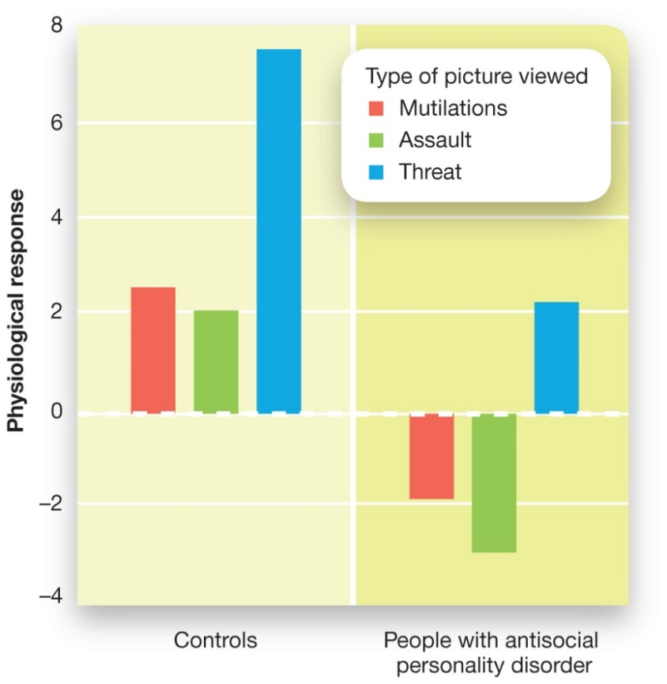
Working the Scientific Literacy Model: The Criminal Psychopath (2 of 3)
Figure 15.3 Emotional Responses of Psychopaths
This graph shows the strength of autonomic response to three types of pictures: mutilations, assault, and threat. Responses are much greater among healthy control subjects (the three bars on the left) than among psychopaths (the three bars on the right).
Notes:
Antisocial personality disorder (APD) (p. 626) refers to a profound lack of empathy or emotional connection with others, a disregard for others’ rights or preferences, and a tendency toward imposing their own desires, often violently, onto others regardless of the consequences for other people or, often when younger, other animals.
1) What do we know about psychopaths?
i) There are some differences between the individuals with APD and psychopaths. Approximately 15% to 20% of people with APD would also be diagnosed with psychopathy.
ii) Psychopaths are frequently diagnosed using the Hare Psychopathy Checklist-Revised (PCL-R; Hare, 2003), a 20-item checklist on which an assessor decides the degree to which a patient matches different characteristics. The PCL-R breaks down into two main factors:
a) The Interpersonal/Emotional factor contains items such as “superficial charm,” “pathological lying,” “lack of empathy,” and “lack of guilt.”
b) The Social Deviance factor contains items such as “need for stimulation,” “impulsivity,” “poor behavioural controls,” and “early behavioural problems.”
iii) People with APD (but who are not psychopaths) tend to score highly on the Social Deviance items. Psychopaths, on the other hand, score high on both
factors, but are particularly high on the Interpersonal/Emotional items. This result has led some psychiatrists to suggest that psychopathy is an extreme form of APD.
2) How can science explain antisocial personality disorder?
i) Psychopaths tend to be under-reactive to stress. For example, a flash of light, a loud sound, or the sudden appearance of an angry face will startle most people. In contrast, psychopaths show very weak startle responses when exposed to unpleasant stimuli.
a) In one study, researchers recorded the electrical signals of the eyeblink muscles while presenting disturbing images to a group of male prisoners from an American jail and a control group (i.e., without a psychological disorder). Figure 15.3 illustrates the results—the strength of the startle response is indicated by the height of the bars. The psychopaths (the bars on the right side) had much weaker responses than the control group (on the left; Levenston et al., 2000).
ii) This reduced reactivity to stress is due, in part, to abnormalities in the amygdala. In most people, the amygdala fires in response to aversive stimuli. It is also involved with aversive conditioning, a form of emotional learning (see Module 6.1). However psychopaths show very little amygdala activity in these situations. Additional impairments occur as a result of problems associated with the frontal lobes. The frontal lobes have connections that allow them to reduce the activity of the amygdala and other emotion-related brain regions (see Module 11.4). Psychopaths, however, have less grey matter in many frontal lobe regions. They also have less efficient white-matter pathways connecting the frontal lobes and amygdala. As a result, they have trouble regulating their emotional responses (see Figure 15.4).
Long Description:
The graph is split into two vertical parts on the x-axis, namely, controls and people with antisocial personality disorder. The y-axis shows physiological response from negative 4 to 8 in increments of 2. The graph shows emotional response to mutilations, assault, and threat higher in control group (left) than the individuals with antisocial personality disorder (right). The details are as follows:
Control:
• Mutilations: 2.5
• Assault: 2
• Threat: 7.5
People with antisocial personality disorder:
• Mutilations: Negative 2
• Assault: Negative 3
• Threat: 2.2

Slide 33
Working the Scientific Literacy Model: The Criminal Psychopath (3 of 3)
Can we critically evaluate this information?
Differences in neural activity – planning instead of empathizing?
Why is this relevant?
Early diagnosis and treatment
Notes:
1) Can we critically evaluate this information?
i) These explanations of psychopathy show us how these individuals react to emotional stimuli and events. But these data don’t explain how psychopaths can manipulate others for their own goals.
a) A neuroimaging experiment using prisoners in Germany, 14 of whom were psychopaths and 14 of whom weren’t, provides an eerie window into the mind of the psychopath. In the study, all participants viewed cartoon drawings in which a character’s goals were fulfilled or unfulfilled. For instance, if a character named Max wanted to throw the ball to a character named Lena, Max’s goals would be fulfilled when he did in fact throw the ball to Lena. His goals would be unfulfilled if he (for some reason) threw the ball to someone else instead. After viewing each cartoon, the participants were asked to indicate if the main character (i.e., Max) would feel happy, sad, or neutral.
b) As would be expected from a very simple task like this, both psychopaths and non-psychopaths answered almost all of the items correctly. There was a large difference in the neural activity that was occurring while they were responding, however. The criminals who were not psychopaths showed increased brain activity in brain areas related to empathy, indicating that they were mentally taking the perspective of the characters. The criminal psychopaths, on the other hand, showed increased activity in frontal-lobe areas related to outcome monitoring and attention. These results suggest that in situations when most people are empathizing, criminal psychopaths are planning.
2) Why is this relevant?
i) Identifying how physiology and brain function differ in psychopaths is certainly helpful for psychologists who are trying to understand the underlying mechanisms of these disturbing behavioural patterns. If a system of early diagnosis and treatment could be instituted, it might be possible to more effectively intervene before the person develops the full manifestation of the disorder, and before they commit any harm.

Slide 34
Avoidant Personality
Antisocial personality disorder (A v P D) (p. 578)
Afraid of embarrassment
Focus on criticism
Avoid forming social bonds
Amygdala response
Notes:
Avoidant personality disorder (AvPD) (p. 578): individuals avoid social interactions, including those at school or work, because they feel inadequate and are deeply afraid of being rejected.
1) People with AvPD tend to avoid trying new things because they are afraid of embarrassing themselves. They also tend to focus on any criticism they might receive, even if it is quite minor. In some cases, people with AvPD will try to protect themselves against the pain of rejection by trying to avoid experiencing emotions altogether. To do this, they avoid forming social bonds.
2) Researchers have found that the amygdala showed larger responses in AvPD participants than in healthy controls when they were asked to judge the emotionality of negative social stimuli. Importantly, the size of the amygdala response during the study was positively correlated with their anxiety levels (i.e., as amygdala activity increased, so did self- reported anxiety).

Slide 35
Dependent Personality
Dependent personality disorder (D P D) (p. 578)
Lack confidence
Fear of abandonment, rejection
Notes:
Dependent personality disorder (DPD) (p. 578) involves an excessive need to be taken care of, often requiring frequent assurance from others and help with everyday decision making.
1) People with DPD have difficulty starting projects on their own because they lack confidence. They are also so afraid of being abandoned that they tend to avoid disagreeing with others.
2) There are some similarities between DPD and AvPD. The fear of being rejected dominates the lives of people with these disorders.
i) What separates the two conditions is that people with AvPD tend to avoid social relationships so that they will not experience rejection, whereas individuals with DPD become excessively clingy to people in their social network because they are afraid of being rejected.

Slide 36
Obsessive-Compulsive Personality (1 of 2)
Obsessive-Compulsive personality disorder (O C P D) (p. 578)
Distressing, maladaptive focus on details and control
Link to Parkinson’s disease, dopamine
Notes:
Obsessive-compulsive personality disorder (OCPD) (p. 578) is a disorder in which individuals are perfectionists who are unusually focused on details, organization, and productivity; these individuals also tend to avoid spending money or throwing out old, worthless objects.
1) OCPD involves a distressing, maladaptive focus on details. People with OCPD often fail to delegate tasks and refuse help from others because they feel that other people will not produce “perfect” work. OCPD also involves stingy spending habits with a focus on saving money and not throwing away old items. As in their work life, the focus here is on control.
2) There have been relatively few studies of the biology underlying OCPD. However, Italian researchers performing research on Parkinson’s disease, a movement disorder caused by damage to dopamine-producing brain areas, noted that OCPD occurred in 40% of their patients (Nicoletti et al., 2013; see Figure 15.5). No other personality disorder exceeded 10%. This result suggests that this disorder is related to the neurotransmitter dopamine.

Slide 37
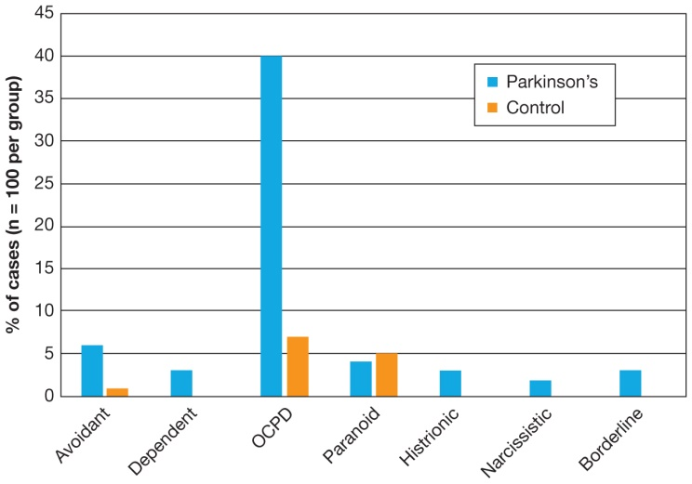
Obsessive-Compulsive Personality (2 of 2)
Figure 15.5 Personality Disorders in Patients with Parkinson’s Disease
Parkinson’s disease is a movement disorder caused by damage to dopamine systems projecting to the basal ganglia in the brain. In one study, 40% of patients with Parkinson’s disease also had O C P D, suggesting that this personality disorder involves dopamine-releasing brain regions.
Source: Adapted from Nicoletti et al. (2013). Obsessive compulsive disorder and Parkinson’s disease. PLoS ONE, 8(1), e54822.
Notes:
Obsessive-compulsive personality disorder (OCPD) (p. 578) is a disorder in which individuals are perfectionists who are unusually focused on details, organization, and productivity; these individuals also tend to avoid spending money or throwing out old, worthless objects.
1) OCPD involves a distressing, maladaptive focus on details. People with OCPD often fail to delegate tasks and refuse help from others because they feel that other people will not produce “perfect” work. OCPD also involves stingy spending habits with a focus on saving money and not throwing away old items. As in their work life, the focus here is on control.
2) There have been relatively few studies of the biology underlying OCPD. However, Italian researchers performing research on Parkinson’s disease, a movement disorder caused by damage to dopamine-producing brain areas, noted that OCPD occurred in 40% of their patients (Nicoletti et al., 2013; see Figure 15.5). No other personality disorder exceeded 10%. This result suggests that this disorder is related to the neurotransmitter dopamine.
Long Description:
The x-axis shows various types of disorders. The y-axis shows percentage of cases, where n equals 100 per group, from 0 to 45 in increments of 5. The details showing Parkinson’s and control across various disorders are as follows:
Avoidant: 6, 1
Dependent: 4, NA
OCPD: 40, 14
Paranoid: 4.5, 5
Histrionic: 3, NA
Narcissistic: 2, NA
Borderline: 3.5, NA

Slide 38
Dissociative Identity Disorder
Dissociative disorder (p. 579)
Dissociative identity disorder (D I D) (p. 579)
1% of patients
Brought on by extreme stress
Difficult to test for
Notes:
1) Almost everyone has experienced a dissociative experience—a sense of separation between you and your surroundings.
i) For example, have you ever driven on a familiar route and suddenly realize you drove past your turn five minutes ago?
ii) These are normal experiences, but those with extreme cases may be diagnosed with dissociative disorder.
Dissociative disorder (p. 579) a category of mental disorders characterized by a split between a person’s conscious awareness and their feelings, cognitions, memory, and identity.
2) Probably the most familiar member of this category is dissociative identity disorder (DID), also referred to as multiple personality disorder.
i) However, only 1% of psychiatric patients have been diagnosed with DID.
Dissociative identity disorder (DID) (p. 579) (sometimes referred to as Multiple Personality Disorder) is a disorder in which a person experiences a split in identity such that they feel different aspects of themselves as though they were separated from each other. This can be severe enough that the person constructs entirely separate personalities, only one of which will generally be in control at a time.
2) Dissociative disorders, such as DID, are thought to be brought on by extreme stress.
i) Most cases of DID do include reports of a stressful event or series of events that precipitated the onset of the condition.
ii) An individual may cope by trying to block out the experience and focus on another time and place.
3) A condition like DID is very difficult to test for, which has raised a lot of skepticism by some.
i) One approach to testing for DID is to check for memory dissociations between alter identities.
a) In one study, patients viewed words and pictures and were tested for recall either when they were experiencing the same alter as when they learned, or when they were experiencing a different alter identity.
b) The results suggested that some types of learning do not transfer between alter identities.
4) Skeptics of DID note that it may have it origins more in the context of therapy, rather than being a response to trauma.
i) In 1970, there were 79 documented cases of DID. This number grew to 6,000 in 1986. By 1998, the number had risen to more than 40,000.
a) This increase could be due to greater awareness. It may also be that a small subset of psychologists find the disorder compelling and are more willing to diagnose it, so they interpret symptoms through that framework, and may (even unintentionally) provoke dissociative symptoms in the context of therapy. The use of highly suggestive techniques such as hypnosis increases the likelihood that this is the case.
ii) About 80% of patients diagnosed with DID were unaware of having the disorder before starting therapy.

Slide 39
15.3 Learning Objectives
Know the key terminology related to anxiety, obsessive-compulsive, and depressive disorders.
Understand the different types of anxiety disorders.
Understand how anxiety or depressive disorders can be self-perpetuating.
Apply your knowledge of anxiety, obsessive-compulsive, and depressive disorders in order to identify which behavioural symptoms are associated with each disorder.
Analyze whether maladaptive aspects of specific phobias might arise from perfectly normal, healthy behaviours.
Notes:
Know the key terminology related to anxiety, obsessive-compulsive, and depressive disorders.
See the bold, italicized terms below.
Understand the different types of anxiety disorders.
Although anxiety disorders share many similarities in symptoms, they differ in terms of what brings about the symptoms and the intensity of the symptoms. The cues that trigger anxiety range widely: In generalized anxiety disorder, just about anything may cause anxiety; in specific phobias, an individual fears only certain objects. Likewise, the intensity can range from near-constant worrying to the brief periods of highly intense anxiety in phobias and panic disorder.
Understand how anxiety or depressive disorders can be self-perpetuating.
Both depression and anxiety are characterized by a vicious cycle: With anxiety, anxious thoughts can lead to physiological arousal; physiological arousal can lead to escape and avoidance to get rid of the immediate fear, which in turn reinforces the anxious thoughts. In depression, a similar pattern can occur with depressed thoughts, self-blame, and social withdrawal.
Apply your knowledge of anxiety, obsessive-compulsive, and depressive disorders in order to identify which behavioural symptoms are associated with each disorder.
Although anxiety disorders share many similarities in symptoms, they differ in terms of what brings about the symptoms and the intensity of the responses.
Analyze whether maladaptive aspects of psychological disorders might arise from perfectly normal, healthy behaviours.
To analyze this issue, we need to examine the specific symptoms that occur in someone who has a phobia and is showing an adaptive response (fear, anxiety) but to an inappropriate stimulus or situation. It is perfectly reasonable and healthy to be cautious about heights, for example, in the sense that falls can be dangerous, even life-threatening. This reaction is maladaptive only when the fear response is so intense or out of context that it interferes with daily life. Imagine a house painter who cannot climb a ladder or scaffold; unless he overcomes his fear (or finds very short houses to work on), he will have to make major adjustments to accommodate his fear.

Slide 40
Anxiety Disorders
Anxiety disorders (p. 583)
Normal stress
Fight-or-flight response
Maladaptive responses
Notes:
1) Anxiety disorders are one of the most frequently diagnosed disorders, affecting approximately one in every eight Canadians.
Anxiety disorders (p. 583) are a category of disorders involving fear or nervousness that is excessive, irrational, and maladaptive.
i) Everyone experiences feelings of anxiety, which is based on a normal physiological and psychological response to stressful events known as the fight-or-flight response.
a) Feelings include a racing heart, increased respiration, sweaty hands, and a knot in the stomach.
b) The changes reflect a shift in energy from non-emergency tasks (e.g., digestion) toward fighting or fleeing.
c) This is an adaptive response common to all mammals.
ii) However, as discussed in Module 15.1, these responses become maladaptive when they go beyond typical psychological responses.

Slide 41
Varieties of Anxiety Disorders
Generalized anxiety disorder (GAD) (p. 583)
Trouble identifying cause of stress
Major life changes
Panic disorder (p. 584)
Panic attacks (p. 584)
Agoraphobia (p. 584)
Avoid public settings
Notes:
1) The primary symptoms of all anxiety disorders include the basic feelings of anxiety.
i) What separates anxiety disorders from other forms of anxiety is a combination of an unjustifiable degree, duration, and source of anxiety.
a) These experiences create distress for the individual and interfere with normal daily functioning at work, at school, and in personal relationships.
Generalized Anxiety Disorder
1) Those with generalized anxiety disorder (GAD) generalize their anxiety to just about anything.
Generalized anxiety disorder (GAD) (p. 583) involves frequently elevated levels of anxiety, generally from the normal challenges and stresses of everyday life.
i) Those with GAD, like other anxiety disorders, have trouble concentrating and sleeping.
ii) However, those with GAD struggle to identify the specific reasons for why they are anxious.
iii) The anxiety people feel with GAD doesn’t seem to go away, even if the issue is resolved.
a) Instead, the anxiety is redirected to the next problem or issue.
2) Major life changes commonly precede the onset of GAD.
i) However, not all factors contributing to GAD are clear.
Panic Disorder
1) Panic disorders are shorter in duration and more intense in comparison to GAD.
Panic disorder (p. 584) is an anxiety disorder marked by occasional episodes of sudden, very intense fear.
i) The key feature of this disorder is panic attacks (p. 584) —brief moments of extreme anxiety that include a rush of physical activity paired with frightening thoughts.
a) A panic attack escalates when the fear of death causes increased physical arousal, and the increased physical symptoms feed the frightening thoughts.
b) These attacks rarely go on for more than 10 minutes, after which the person returns to a more relaxed state.
2) People with panic disorder often develop an intense fear that the panic will strike again.
Agoraphobia (p. 584): an intense fear of having a panic attack in public; as a result of this fear, the individual may begin to avoid public settings and increasingly isolate themself.
i) The individual may begin to avoid public settings so as to avoid the embarrassment and trauma of a panic attack.
a) In its most extreme forms, agoraphobia leads an individual to stay inside his or her home almost permanently.

Slide 42
The Vicious Cycle of Anxiety Disorders
Table 15.2 Five Main Types of Phobias
Clinical researchers have identified five main categories of specific phobias. Most studies report that approximately 5% of the population is currently experiencing one or more of the natural environment, situational, animal, or blood/injection/injury phobias. Approximately 40–60% of the population has experienced one of these phobias at one time in their lives. The prevalence of “other types” of phobias is lower, with approximately 1% of the population currently experiencing this phobia and 10% having experienced at some point in their lives.
Type of Phobia | Examples
Natural environment type | Heights, thunderstorms, large bodies of water
Situational type | Closed spaces (e.g., elevators), crowds
Animal type | Spiders, snakes, mice
Blood/injection/injury type | Seeing blood or broken bones, seeing needles
Other type | Fear of vomiting or choking
Source: Information is derived from the Centre for Addictions and Mental Health (C A M H) (2019). Retrieved from https://www.camh.ca/en/health-info/ mental-illness-and-addiction-index/phobias.
Notes:
1) One of the most difficult aspects of anxiety disorders is that they tend to be self-perpetuating (Figure 15.6).
i) For example, a child may be scratched by the neighbour’s cat.
a) She was not seriously hurt, but years later, she still feels nervous around cats.
b) She might even be reluctant to go into a house if the owner has a cat.
c) Once the cat is put into another room, the anxiety fades.
ii) This process of reducing the fear, in turn, can reinforce the phobia.

Slide 43
Working the Scientific Literacy Model: Specific Phobias (1 of 3)
What do we know about specific phobias?
Table 15.3 Prevalence of Symptoms in a Survey of 293 Individuals with Obsessive–Compulsive Disorder
Percentage of Sample Experiencing Obsession | Specific Types of Obsessions
58% | A fear of being contaminated
56% | Persistent doubting
48% | Need to arrange things in a symmetrical pattern
45% | Aggressive thoughts
Percentage of Sample Experiencing Compulsion | Specific Types of Obsessions
69% | Checking
60% | Cleaning
56% | Repeating actions
Source: Based on Pinto, A., Mancebo, M., Eisen, J., Pagano, M., & Rasmussen, S. (2006). The Brown longitudinal obsessive–compulsive study: Clinical features and symptoms of the sample at intake. Journal of Clinical Psychiatry, 67, 703–711.
Notes:
1) In contrast to GAD, where an individual’s anxiety can be applied to just about any situation, individuals can have more specific fears (Table 15.3).
Phobia (p. 584) is a severe, irrational fear of a very specific object or situation.
Specific phobias (p. 584) involve an intense fear of an object, activity, or organism.
i) Specific phobias include fears of specific animals, heights, thunder, blood, or injections.
2) What do we know about specific phobias?
i) Phobias are developed through unpleasant or frightening experiences.
a) For example, someone who is bitten by a dog might develop a phobia of dogs.
b) However, not all who are bitten will develop a phobia.
ii) We may be biologically predisposed to fear some objects more than others.
a) Most phobias are of objects and situations that we may need to fear for survival (e.g., heights and snakes).

Slide 44
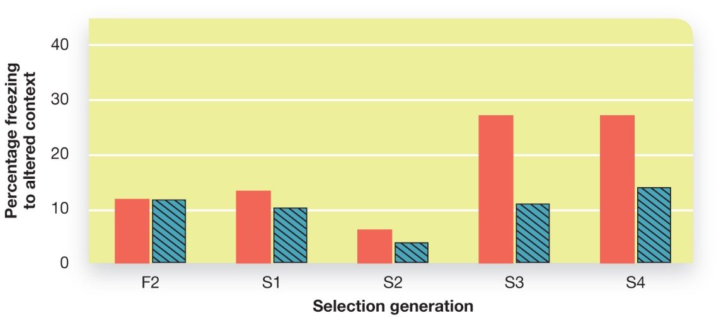
Working the Scientific Literacy Model: Specific Phobias (2 of 3)
How can science explain why some people are more likely to develop specific phobias?
Figure 15.7 Anxiety Levels Are Inherited in an Animal Model
Over the course of just a few generations, mice from the highly fearful genetic strain show increasingly strong fear responses as indicated by the height of the red bars. The blue bars represent the responses of a typical genetic strain of mice (i.e., the control group).
Notes:
Long Description:
The x-axis shows mice with fearful genetic strain represented by F2 and four generations represented by S1, S2, S3, and S4. The y-axis shows percentage freezing to altered context from 0 to 40 in increments of 10. The graph shows the mice with fearful genetic strain show increasing fear response indicated by the red bar. The details of the graph with red and blue bars are as follows:
• F2: 11, 11.
• S1: 12, 10.
• S2: 3.5, 2.5.
• S3: 28, 10.5.
• S4: 28, 15.

Slide 45
Working the Scientific Literacy Model: Specific Phobias (3 of 3)
Can we critically evaluate this information?
Humans are not mice
Genetics could only partially explain phobias
Why is this relevant?
Treatment of phobias
Notes:
1) Can we critically evaluate this information?
i) We may question the value of this research because, on the face of it, we don’t seem to have learned much about phobias from studying genetic heritability of fear-responses in mice. However, understanding that genes can influence fear responses in another mammalian species suggests that genes likely underlie our own reactions to threatening stimuli and situations.
ii) A second potential criticism of this research is that it only examines fear responses from one perspective: genetics. The full manifestation of a phobia involves many processes and, therefore, would only be partially explained by a genetic understanding.
2) Why is this relevant?
i) Knowing that some phobias may have a genetic component, professionals might not treat all phobias the same way.
ii) A challenge for the future is to understand the interaction between the genetic and other levels of analysis in order to fully develop these tools. Doing so may lead to new treatment for a number of disorders.

Slide 46
Anxiety Disorders (1 of 2)
Social anxiety disorder (p. 586)
Prefer familiar places and routines
Obsessive-compulsive disorder (O C D) (p. 586)
Notes:
Social Phobias
Social anxiety disorder (p. 586) is a very strong fear of being judged by others or being embarrassed or humiliated in public.
1) Someone with a social anxiety disorder can go out in public, but prefers familiar places and routines and will avoid many other situations because anxiety levels are too high.
i) For example, a student might show up to class right as it begins so that s/he doesn’t have to have awkward conversations in the hall or worse, be the only one not having a conversation.
ii) S/he may be very hungry, but won’t go to the cafeteria because his/her roommate isn’t around and s/he cannot sit with strangers (especially without the roommate).
a) So s/he gets a snack out of the vending machine and sits quietly behind the library.
2) We all may do such things from time to time, but do you shape your life around such events? Is it maladaptive?
Obsessive-Compulsive Disorder
1) Other anxiety disorders are trademarked by intrusive thoughts and repetitive behaviours (Table 15.4).
i) The compulsive behaviours that people with OCD engage in are thought to be a way of coping with the anxiety produced by the obsession.
Obsessive-compulsive disorder (OCD) (p. 586): the individuals is plagued by unwanted, inappropriate, and persistent thoughts (obsessions), and engages in repetitive, often quite ritualistic behaviours (compulsions).
ii) Until 2013, OCD was categorized as one of the anxiety disorders, although in the DSM-5, OCD was placed into its own category.
2) All of us have had unwanted thoughts stuck in our head (e.g., a song), but obsessions are generally inappropriate thoughts that can last for months or years.
i) For example, a person might imagine picking up germs from everything s/he touches.
a) Many psychologists believe that compulsive behaviours, and the relief they provide, give the person a feeling of control over their anxiety. They just have to perform a very particular behaviour in order to feel that control.

Slide 47
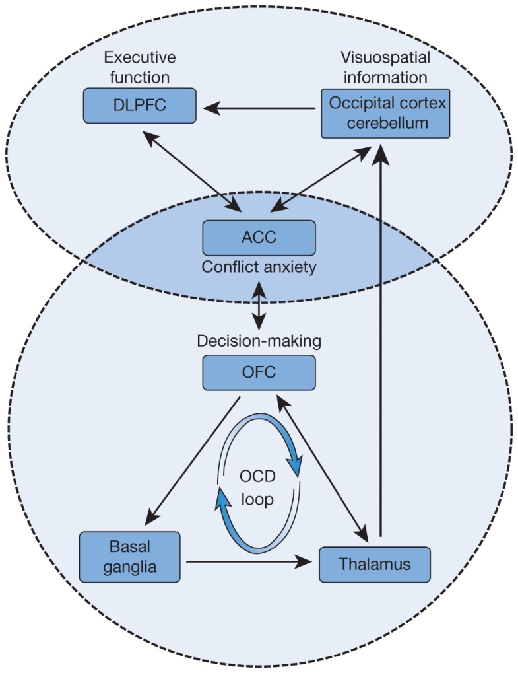
O C D and the Brain
Figure 15.8 Obsessive–Compulsive Disorder and the Brain
O C D involves impairments in two “loops” in the brain. The orbitofrontal loop consists of the orbitofrontal cortex, basal ganglia, and thalamus. It is related to many O C D behaviours. A second neural “loop” or network consists of the dorsolateral prefrontal cortex, anterior cingulate cortex, and visual regions at the back of the brain. Dysfunction of this network is associated with many of the cognitive symptoms that occur in O C D, such as problems with working memory and attentional control.
Source: Adapted from Nakao, T., Okada, K., & Kanba, S. (2014). Neurobiological model of obsessive-compulsive disorder: Evidence from recent neuropsychological and neuroimaging findings. Psychiatry and Clinical Neurosciences, 68, 587-605.
Notes:
1) The fact that OCD often involves a specific, repeated action suggests that the biology underlying this mental illness is different from that of anxiety disorders.
i) Early studies suggested that OCD was due to a smaller orbitofrontal cortex.
a) This difference, in turn, influenced the efficiency of a brain network including the orbitofrontal cortex, parts of the basal ganglia, and the thalamus. This network has been called the orbitofrontal loop. The orbitofrontal loop contains structures related to key features of OCD. The orbitofrontal cortex is involved in decision making, the basal ganglia are involved with movement and reward, and the thalamus is involved with taking in sensory information.
ii) More recent explanations for OCD built upon this earlier work and attempted to explain some of the cognitive symptoms that often accompany OCD, such as problems with working memory and attentional control.
a) In this model of the disorder, OCD is still associated with a poorly performing orbitofrontal loop. But it also involves abnormal activity in other brain regions, including the dorsolateral prefrontal cortex, an area involved with attentional control and problem solving, and the anterior cingulate cortex, a frontal-lobe area that is involved in both attention and emotion (see Figure 15.8). The weaker responses of these difference brain areas may explain the behaviours of many patients with OCD.
Long Description:
The details of the diagram are as follows:
The circle with OCD loop in the brain consists of decision making factors, namely, OFC, basal ganglia, and thalamus.
OFC and thalamus are connected with bidirectional arrows and an arrow from thalamus in the first circle leads to OCC in the second circle.
The second circle consists of a neutral loop of executive function, visuospatial information, and conflict anxiety, represented by DLPFC, occipital cortex cerebellum, and ACC.
ACC or conflict anxiety is in the intersecting part of the two circles and is connected by bidirectional arrows with DLPFC, OCC, and OFC.

Slide 48
Mood Disorders
Major depression (p. 587)
Depressed cognition
Lethargic and sleep
Insomnia
Appetite change
Digestive problems
Notes:
Mood Disorders
1) Mood disorders, such as bipolar disorder and depression, are particularly common, affecting nearly 10% of adults in Canada and the U.S..
i) Due to biopsychosocial factors, rates of depression are twice as high among women than men and three times as high among people living in poverty.
ii) There is an underlying genetic risk for developing major depression.
Major Depression
1) We have all felt sad or depressed at some time, but clinical depression can be very severe and occurs even when there are no events or circumstances we would associate with a depressed mood.
Major depression (p. 587) is a disorder marked by prolonged and periods of sadness, feelings of worthlessness and hopelessness, social withdrawal, and cognitive and physical sluggishness.
2) Major depression involves more than just feeling sad for a long period of time.
i) Cognition becomes depressed as well.
a) Therefore, individuals have difficulty concentrating and making decisions while memories shift toward unpleasant and unhappy events.
ii) Physiologically, affected individuals may be lethargic and sleepy, yet experience insomnia.
iii) Individuals may experience a change in appetite and the onset of digestive problems (e.g., constipation).

Slide 49
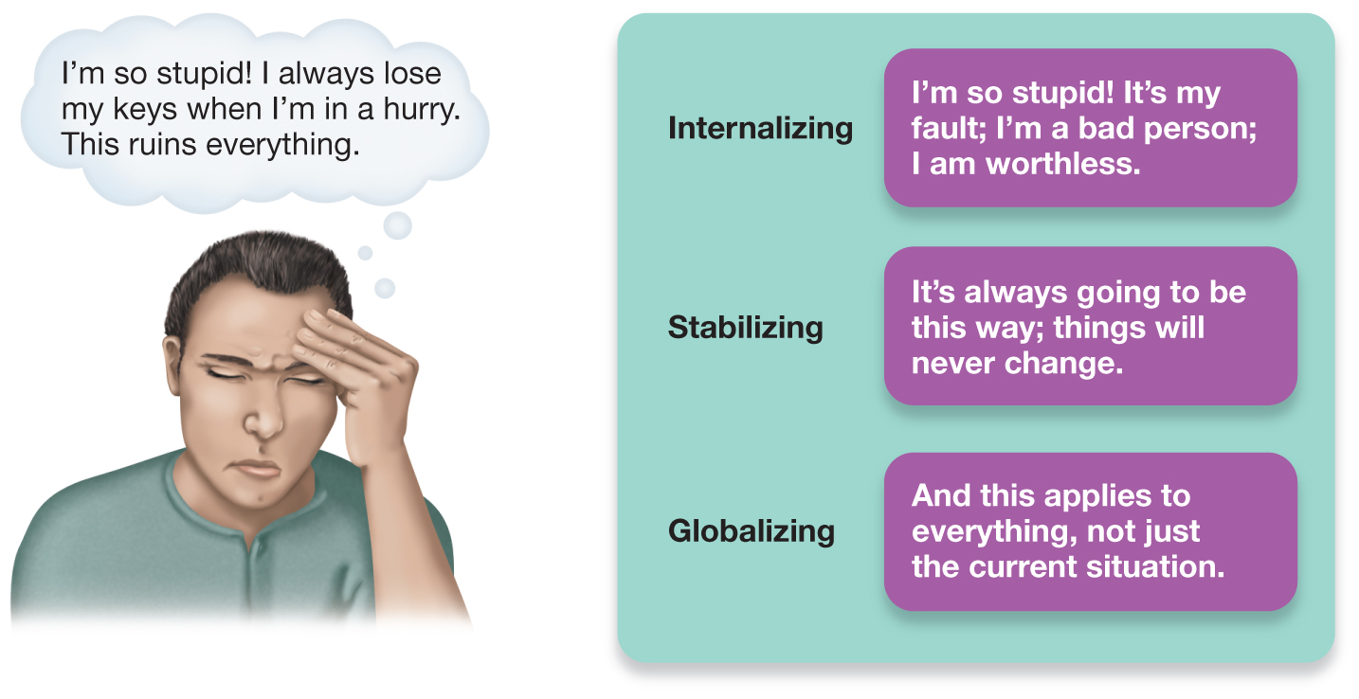
Cognitive Aspects of Depression
Figure 15.9 Three Elements of the Depressive Explanatory Style
The three elements of the depressive explanatory style are internalizing, stabilizing, and globalizing.
Notes:
1) Those suffering from depression often develop a depressive explanatory style, in which the person explains life with three qualities: internal, stable, and global (Figure 15.10).
i) For example, let’s say you lose your keys. If you have a depressive explanatory style, you would think, “I’m so stupid! I always lose my keys when I’m in a hurry. This ruins everything”:
a) Internal: I’m so stupid, it’s all my fault, I’m worthless.
b) Stable: It’s always going to be this way; things will never change.
c) Global: This applies to everything, not just the current situation.
Long Description:
The image in the left depicts a depressed person saying that “I’m so stupid! I always lose my keys when I’m in a hurry. This ruins everything.”
The image in the right shows the examples of and three elements of the depressive explanatory style.
Internalizing- I’m so stupid! It’s my fault; I’m a bad person; I am worthless.
Stabilizing- It’s always going to be this way; things will never change.
Globalizing- This applies to everything, not just the current situation.

Slide 50
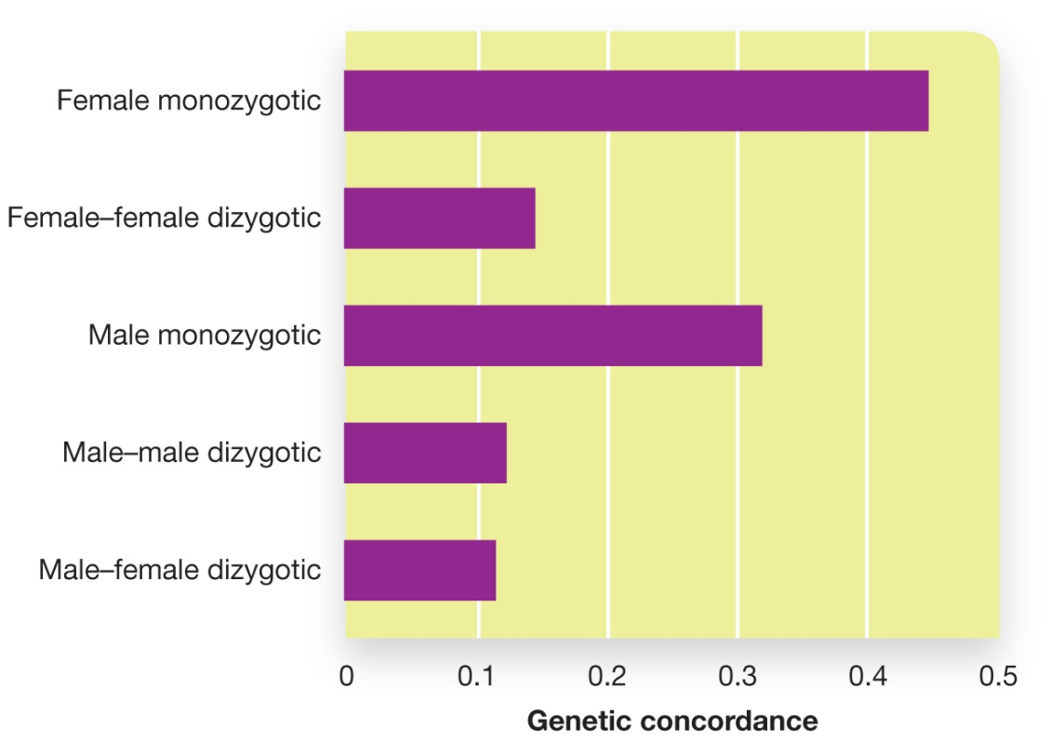
Genetic Vulnerability to Depression (1 of 2)
Figure 15.10 Genetic Relatedness and Major Depression
Identical (monozygotic) twins have a greater chance of both developing major depression compared to fraternal (dizygotic) twins. Notice that the genetic correlation is highest for female monozygotic twins.
Notes:
1) Twin studies suggest an underlying genetic risk factor for developing major depression (see Figure 15.10).
i) Additionally, behavioural genetics researchers have found that people who inherit two copies of the short version of a relevant gene are at greater risk for developing depression, whereas those who inherit two long copies are at a far lower risk. But what is critical here is not just which genes are inherited, but also how much stress people experience.
ii) As the number of major stressful life events increases, those who inherit two copies of the short version of this gene are far more likely to develop depression, whereas those who inherit two long copies are buffered from depression (Figure 15.11). People who inherit one copy of each gene (are heterozygous) show intermediate responses to stressful events. Notice that the type of serotonin gene inherited has no effect on depression after only one or two major stressful events.
iii) The gene–environment interaction becomes apparent after an accumulation of events. This interaction between a genetic predisposition for a disorder and life stress is known as the diathesis–stress model (p. 589) of psychological disorders.
Long Description:
The genetic correlation for major depression is shown to be high in between female monozygotic twins than dizygotic twins. The x-axis shows genetic concordance from 0 to 0.5 in increments of 0.1 and the y-axis shows genetic relatedness. The details of the graph are as follows:
Male and female dizygotic: 0.12
Male and male dizygotic: 0.13
Male monozygotic: 0.33
Female and female dizygotic: 0.15
Female monozygotic: 0.45

Slide 51
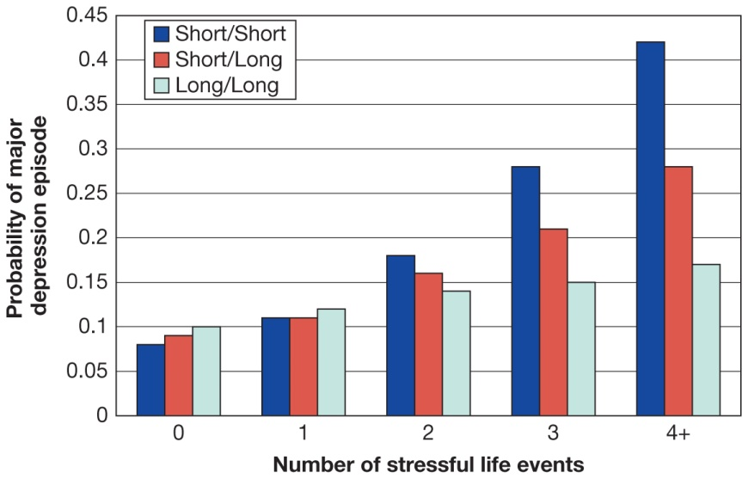
Genetic Vulnerability to Depression (2 of 2)
Figure 15.11 Gene and Environment Interactions in Depression
Stress interacts with genes and influences whether someone becomes depressed. People who inherit two copies of the short version of a gene that codes for serotonin activity in nerve cells are at an increased risk for becoming depressed in response to major life stressors. Those who inherit two long copies are buffered from becoming depressed as life stressors accumulate.
Source: Based on A. Caspi et al., (2003). Influence of life stress on depression: Moderation by a polymorphism in the 5-HTT gene. Science, 301(5631), 386–389.
Notes:
1) Twin studies suggest an underlying genetic risk factor for developing major depression (see Figure 15.10).
i) Additionally, behavioural genetics researchers have found that people who inherit two copies of the short version of a relevant gene are at greater risk for developing depression, whereas those who inherit two long copies are at a far lower risk. But what is critical here is not just which genes are inherited, but also how much stress people experience.
ii) As the number of major stressful life events increases, those who inherit two copies of the short version of this gene are far more likely to develop depression, whereas those who inherit two long copies are buffered from depression (Figure 15.11). People who inherit one copy of each gene (are heterozygous) show intermediate responses to stressful events. Notice that the type of serotonin gene inherited has no effect on depression after only one or two major stressful events.
iii) The gene–environment interaction becomes apparent after an accumulation of events. This interaction between a genetic predisposition for a disorder and life stress is known as the diathesis–stress model (p. 589) of psychological disorders.
Long Description:
The horizontal axis represents the number of stressful life events and ranges from 0 to 4, in increments of 1. The vertical axis represents the probability of major depression episode and ranges 0 to 0.45, in increments of 0.5.
The data corresponding to the stressful events and depression episode is summarized below:
The three bars in this graph are for short and short, short and long, and long and long.
For Short and Short:
• Events: 0; Episodes: 0.75.
• Events: 1; Episodes: 0.11.
• Events: 2; Episodes: 0.18.
• Events: 3; Episodes: 0.27.
• Events: 4 plus; Episodes: 0.42.
For Short and Long:
• Events: 0; Episodes: 0.9.
• Events: 1; Episodes: 0.11.
• Events: 2; Episodes: 0.16.
• Events: 3; Episodes: 0.21.
• Events: 4 plus; Episodes: 0.26.
For Long and Long:
• Events: 0; Episodes: 1.
• Events: 1; Episodes: 0.12.
• Events: 2; Episodes: 0.14.
• Events: 3; Episodes: 0.15.
• Events: 4 plus; Episodes: 0.17.

Slide 52
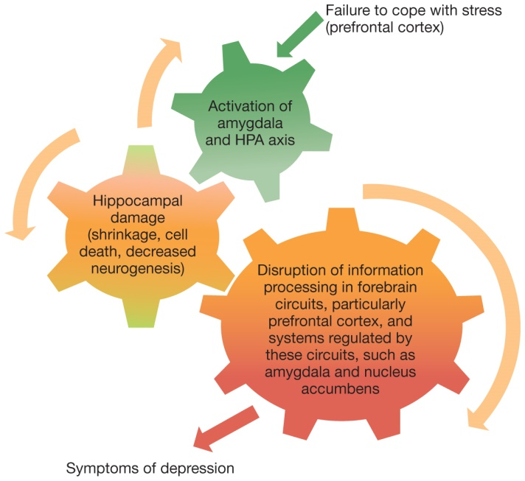
Biological Aspects of Depression
Figure 15.12 Stress, Depression, and the Brain
The HPA axis is stimulated by the amygdala and inhibited by the hippocampus and prefrontal cortex. If the amygdala is overactive, as sometimes occurs in depression, this will upset the balance and lead to the release of stress hormones. These hormones can damage cells in the hippocampus, which further reduces its ability to inhibit stress responses.
Source: From Willner, P., Scheel-Krüger, J., & Belzung, C. (2013). The neurobiology of depression and antidepressant action. Neuroscience and Biobehavioral Reviews, 37, 2331–2371.
Notes:
1) The diathesis-stress model of depression suggests that when people who are genetically prone to developing depression experience life stressors, this nature-nurture interaction will alter the activity of various brain areas. This, in turn, will lead to symptoms of major depression.
i) One brain structure that seems to be involved is the amygdala. This structure is involved with immediate responses to emotional stimuli (see Module 11.4). The amygdala also stimulates the hypothalamus-pituitary-adrenal (HPA) axis, a system involved with stress responses (see Module 14.2). In all of us—depressed or non-depressed—input from the amygdala leads to an increase in the release of stress hormones such as cortisol. In order to prevent this stress response from getting out of control, the HPA access is inhibited by inputs from the hippocampus and frontal lobes. This balance ensures that the body will release levels of stress hormones that are appropriate to the situation.
2) In the depressed brain, the amygdala is frequently overactive and overstimulates the HPA axis (see Figure 15.12). As a result, larger amounts of cortisol circulate in the body. Cortisol has an additional effect on our emotional responses: it damages cells in the hippocampus. As a result, this structure provides less inhibition to the HPA axis, meaning that more stress hormones will be released. This leads to increased anxiety and a negative mood.
i) The long-term effect of this process is that the brain becomes more sensitive to stressful events.
ii) Damage to cells in the hippocampus has another sinister effect: it reduces the growth of new neurons. Scientists have speculated that neurogenesis in the hippocampus can have an antidepressant effect because it can support new learning and more flexible thinking.
3) There are two additional brain areas that can be dysfunctional in depression.
i) The first is the nucleus accumbens, a brain area related to positive rewards (see Module 5.3). This structure is not as active in individuals with depression. This difference may explain why some people with this mental illness experience anhedonia, a reduced ability to feel pleasure, and become less interested in activities that they used to love performing.
ii) The second brain region that shows altered activity is the medial part of the prefrontal cortex. Individuals with abnormally high activity in this brain area are more prone to rumination. As a result, these individuals will continue to think about negative events, even when it would be better to move on to a different line of thinking.
4) Given the number of brain areas involved in depression, it is easy to wonder how taking an anti-depressant pill can help. The answer is that these pills influence the levels of specific neurotransmitters—serotonin, dopamine, and norepinephrine—that are involved in depression. Serotonin appears to be particularly important. People with depression typically have lower serotonin levels in several brain regions, including the amygdala, than non-depressed individuals. Many anti-depressant medications block the reuptake of serotonin, which leaves more serotonin in the synapse available to stimulate the post-synaptic neurons. This process slowly changes the firing rates in the amygdala, hippocampus, and prefrontal cortex so that the depressed individual is less responsive to stress and less likely to ruminate.
i) Although anti-depressants help reduce the symptoms of depression, the brains of people who are not depressed but are taking anti-depressants still differ from the brains of people who were not depressed in the first place. That is one reason why people can still relapse into depression after anti-depressant treatments.
Long Description:
An external factor namely “Failure to cope with stress” from the prefrontal cortex sets the gear in motion leading to symptoms of depression. The details of the diagram are as follows:
• Activation of amygdala and HPA axis
• Hippocampal damage (shrinkage, cell death, decreased neurogenesis)
• Disruption of information processing in forebrain circuits, particularly prefrontal cortex, and systems regulat-ed by these circuits, such as amygdala and nucleus accumbens.

Slide 53
Sociocultural and Environmental Influences on Depression
Substandard housing, crime rates, economic stressors
Social factors
Social Media
Notes:
1) Given the importance of life stressors in our discussion of depression, it is important to identify sociocultural and environmental factors that are associated with this psychological disorder.
i) For example, the quality of a person’s home neighbourhood can be a risk factor for depression. Poor neighbourhoods are associated with higher daily stress levels due to substandard housing and facilities, increased crime rates, and other difficulties. Also, people living in these neighbourhoods are more vulnerable to economic stressors such as unemployment because they generally lack the social connections and the educational and professional opportunities that are available to people living in high-income areas.
ii) Environmental influences, such as poverty, can interact with social factors. For example, poor neighbourhoods often have weaker and less supportive social networks in the community. Lower rates of home ownership and higher rates of turnover make it less likely that people will get to know their neighbours; this makes long-lasting social relationships (i.e., potential sources of support) much less common.
iii) Although the effects of the physical and social environment on depression are well-established, less is known about a different environment that almost everyone now inhabits: social media. Recent research suggests, however, that the electronic environment can influence the development and severity of mood disorders like depression.

Slide 54
Bipolar Disorder
Bipolar disorder (p. 592)
1/3 as often as depression
Episodes vary in length and duration
Mania can take several forms
Difficult to treat
High rates of suicide
Notes:
1) Bipolar disorder involves depression at one end and mania (an extremely energized, positive mode) at the other end.
Bipolar disorder (p. 592) (formerly referred to as manic depression) is characterized by extreme highs and lows in mood, motivation, and energy.
i) This disorder occurs a third as often as depression.
ii) Individuals’ manic episodes can vary in length and duration.
a) Some people experience only a few manic episodes in their lives, whereas others go through manias several times each year.
b) Some are known as “rapid cyclers” and experience very abrupt mood swings, sometimes within hours.
2) Mania may take several forms, however during most episodes the individual is so energetic that they do not feel distress until the mania has passed.
i) Some individuals talk so fast that their thoughts cannot keep up.
ii) Others run up credit card bills of thousands of dollars with the idea that somehow they can afford it.
iii) Those experiencing mania may be sexually charged or ready to fight.
3) Bipolar disorder is relatively difficult to treat because some individuals stop taking their medication when they are in their manic state. Bipolar comes with an additional concern: the increase in energy that occurs when people move from a depressed to a manic phase sometimes allows individuals to act on the negative, self-defeating thoughts that they were experiencing during their depression.
i) Rates of suicide are slightly higher for people with bipolar disorder than for people with major depression.

Slide 55
Suicide
Table 15.4 Warning Signs of Suicide
Learn how to recognize the danger signals. Be concerned if someone you know
Talks about dying by suicide
Has trouble eating or sleeping
Exhibits drastic changes in behaviour
Withdraws from friends or social activities
Loses interest in school, work, or hobbies
Prepares for death by writing a will and making final arrangements
Gives away prized possessions
Has attempted suicide before
Takes unnecessary risks
Has recently experienced serious losses
Seems preoccupied with death and dying
Loses interest in their personal appearance
Increases alcohol or drug use
Source: American Psychological Association. (2011). Suicide warning signs. Retrieved from www.apa.org/topics/suicide/signs.aspx
Notes:
1) Recent statistics rank suicide as the 2nd most frequent cause of death among Canadian youth.
i) Suicide is four times more likely among males than females.
ii) It is more common in aboriginal communities.
iii) Although many believe adolescents are at greatest risk, suicide is highest among the elderly (nearly 60% higher than teens).
2) There are a number of signs and risk factors associated with suicide (Table 15.5).
i) Among persons in their teens and early 20s, the most significant risk factors are:
a) Mood disorders, recent and extremely stressful life events, a family history of mood disorders (with or without suicide), easy access to a lethal means of suicide (most significantly, firearms), and the presence of these factors in conjunction with substance abuse.
ii) For younger individuals, being the victim of bullying and ostracism is a risk factor. However, it is a greater concern when youth are both the victims and the perpetrators of bullying.
iii) Individuals may express despair and hopelessness.
a) “I just want to give up. Nothing matters anymore. They’ll be sorry when I’m gone.”
iv) Other signs include giving away personal possessions, suddenly withdrawing from work or school, crying spells, or obtaining a means of committing the act.

Slide 56
PSYCH @ The Suicide Helpline
Originally religious-based
Empathy and active listening
Problem-solving approach
Best crisis responders use both resources
http://www.suicidepreventionlifeline.org/
http://suicideprevention.ca/need-help/
Notes:
1) The first helplines where religious based and emphasized empathy and active listening.
i) However, this doesn’t meet the needs of all callers.
2) Others take a problem-solving approach, including evaluation, referral, treatment, and follow-up.
3) It turns out that good crisis telephone responders use both styles, depending on the circumstances.
i) First-time callers tend to benefit more from an active listener, who will be nonjudgmental, compassionate, and reflective.
ii) Repeat callers also need compassion, but tend to benefit more if the listener engages in problem-solving strategies.
4) Almost all Canadian universities have emergency crisis lines. For people aged 20 and under, the Kids Help Phone is also available at 1-800-668-6868. Some helpful resources can be found at http://www.suicidepreventionlifeline.org/ and http://suicideprevention.ca/need-help/.

Slide 57
15.4 Learning Objectives
Know the key terminology associated with schizophrenia.
Understand how different neurotransmitters affect individuals with schizophrenia.
Understand the genetic and environmental contributions to schizophrenia.
Apply your knowledge to identify different forms of schizophrenia.
Analyze claims that schizophrenia is related to genius or violent behaviour.
Notes:
Know the key terminology associated with schizophrenia.
See the bold, italicized terms below.
Understand how different neurotransmitters affect individuals with schizophrenia.
Part of how we can explain schizophrenia is by identifying the neurotransmitter chemicals that are affected by the disorder. Individuals with schizophrenia have overactive receptors for the neurotransmitter dopamine. The excess dopamine may be involved in producing the positive symptoms (e.g., hallucinations), but not the negative symptoms (e.g., flattened affect). Glutamate appears to be underactive in brain regions, including the hippocampus and the frontal cortex.
Understand the genetic and environmental contributions to schizophrenia.
The neurodevelopmental hypothesis claims that at least some neurological abnormalities are present at birth, although it does not state to what degree these abnormalities are genetic or environmental. Nevertheless, some research suggests that prenatal exposure to the flu or to significant amounts of stress hormones are all risk factors for this type of mental illness. Genetics seem to play a role, as twin studies show that if one identical twin has schizophrenia, the other has a 50% chance of developing the disorder—a substantial increase over the 1% occurrence rate in the general population.
Apply your knowledge to identify different forms of schizophrenia.
Students should be able to read an individual’s symptoms and identify which form of schizophrenia they most closely match.
Analyze claims that schizophrenia is related to genius or violent behaviour.
Some high-profile cases highlight people with schizophrenia who are intellectually brilliant. In reality, however, research tells us that the average intelligence of people with schizophrenia is not much different from those of the general population; in fact, it is a little bit lower than the norm. Similarly, the belief that schizophrenia leads to violence derives from a small group of high-profile examples. In truth, there does not seem to be increased risk of violence associated with schizophrenia. Those with mental illness are actually more likely to be victims of crime.

Slide 58
Symptoms and Types of Schizophrenia (1 of 3)
Schizophrenia (p. 596)
Stages (p. 596)
Prodromal phase
Active phase
Residual phase
Notes:
1) Schizophrenia is among the most debilitating of psychological conditions.
i) Writings from early history describe people who seem to have lost touch with reality, who hear voices from within, and who produce bizarre speech and behaviours.
ii) An estimated 4 to 8 out of every 1000 adults will experience schizophrenia.
iii) Symptoms may begin to occur and escalate very gradually, remaining largely unnoticeable for a long time before family members start to perceive a pattern. In other cases, however, symptoms can begin and escalate very rapidly.
Schizophrenia (p. 596) is a brain disease that causes the person to experience significant breaks from reality, a lack of integration of thoughts and emotions, and problems with attention and memory.
2) In most cases of schizophrenia, there are three distinct phases: prodromal, active, and residual. These tend to occur in sequence, although individuals may cycle through all three many times.
Prodromal phase (p. 596): people may become easily confused and have difficulty organizing their thoughts, they may lose interest and begin to withdraw from friends and family, and they may lose their normal motivations, withdraw from life, and spend increasing amounts of time alone, often deeply engrossed in their own thoughts.
Active phase (p. 596): people typically experience delusional thoughts, hallucinations, or disorganized patterns of thoughts, emotions, and behaviour.
Residual phase (p. 596): the predominant symptoms have disappeared or lessened considerably, and they may simply be withdrawn, have trouble concentrating, and generally lack motivation.

Slide 59
Symptoms and Types of Schizophrenia (2 of 3)
Positive symptoms (p. 596)
Hallucinations
Delusions
Negative symptoms (p. 596)
Disorganized behaviour (p. 597)
Cognitive functioning
Working memory
Social interaction
Notes:
1) Some professionals prefer to classify symptoms into positive and negative categories versus using subtypes.
i) Positive symptoms involve the presence of maladaptive behaviour.
ii) Negative symptoms include absent or flat emotional reactions as well as lack of speech and motivation.
Positive symptoms (p. 596) refer the presence of maladaptive behaviours, such as confused and paranoid thinking, and inappropriate emotional reactions.
Negative symptoms (p. 596) involve the absence of adaptive behaviour, such as absent or flat emotional reactions, lack of interacting with others in a social setting, and lack of motivation.
2) Common positive symptoms include hallucinations and delusions.
Hallucinations (p. 596) are alterations in perception, such that a person hears, sees, smells, feels, or tastes something that does not actually exist, except in that person’s own mind.
Delusions (p. 596) are beliefs that are not based on or well integrated with reality.
i) For example, a person with schizophrenia may have a delusion of grandeur, believing that he is Jesus, the Pope, or the President.
3) In addition to hallucinations and delusions, individuals with schizophrenia often have disorganized behaviour.
Disorganized behaviour (p. 597) describes the considerable difficulty people with schizophrenia may have completing the tasks of everyday life—cooking, taking care of one’s hygiene, socializing.
4) Individuals with schizophrenia experience several problems with cognitive functioning.
i) Working memory is impaired most likely due to significant neurological decline found in patients with schizophrenia.
a) This likely explains, in part, the disorganized thoughts and speech characteristic of schizophrenia.
5) Social interaction is difficult for many people with schizophrenia.
i) They have difficulty reasoning about social situations and show relatively poor social adjustment.
ii) Their emotional expressions and ability to react to the emotions of others may be impaired.
a) For example, people with schizophrenia may have a neutral masklike expression on their faces, and show little responses to smiles or other expressions from others.

Slide 60
Symptoms and Types of Schizophrenia (3 of 3)
Subtypes (p.598)
Paranoid
Disorganized
Catatonic
Notes:
1) Symptoms of schizophrenia cluster into different patterns, which professionals subtype into the following disorders. These subtypes were dropped from official practice in 2013 (at least, according to the DSM-5), but they are still commonly used:
i) Paranoid schizophrenia (p. 598): symptoms include delusional beliefs that one is being followed, watched, or persecuted, and may also include delusions of grandeur or the belief that one has some secret, insight, power, or some other characteristic that makes one particularly special. .
ii) Disorganized schizophrenia (p. 598): symptoms include thoughts, speech, behaviour, and emotion that are poorly integrated and incoherent.
a) People with disorganized schizophrenia may also show inappropriate, unpredictable mannerisms.
iii) Catatonic schizophrenia (p. 598): symptoms include episodes in which a person remains mute and immobile—sometimes in bizarre positions—for extended periods.
a) Individuals may also exhibit repetitive, purposeless movements.

Slide 61
Myths in Mind: Schizophrenia is Not a Sign of Violence or Genius
Myths
Split personality
Madness goes with genius
Dangerous
High-profile cases
Ted Kaczynski
John Nash
A Beautiful Mind
Notes:
1) There are a number of myths surrounding schizophrenia.
i) Some people believe the disorder involves a “split personality,” but that is actually dissociative identity disorder (DID) (Module 15.2).
ii) Others believe “madness” goes along with genius.
iii) There is also a belief that those with schizophrenia are dangerous.
2) One reason these myths persist is due to high-profile cases:
i) Ted Kaczynski, known as the “Unabomber,” was a math genius who sent mail bombs to prominent researchers at various universities.
ii) John Nash is another math genius who peacefully works at Princeton University.
a) The film A Beautiful Mind is based on his life story.
3) However, most people with schizophrenia score slightly below average on IQ tests.
4) Also, few individuals with schizophrenia commit offenses even approaching the level of violence committed by Kaczynski.
i) Violence that is committed is usually fueled by substance abuse and other factors unrelated to the illness.
ii) It is more likely that people with mental illness will be victims of crime—approximately 10 times more likely than non-mentally ill people.

Slide 62
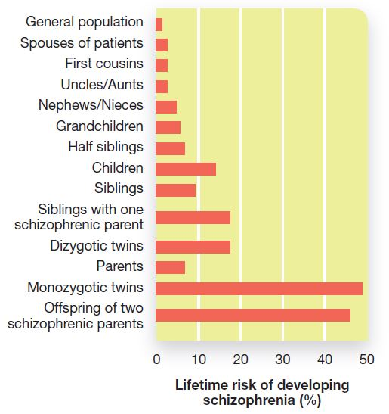
Explaining Schizophrenia: Genetics
Figure 15.13 Genetic Influences for Schizophrenia
The more genetic similarity an individual has to a person with schizophrenia, the more likely that he or she will also develop the disorder.
Notes:
1) Studies using twin, adoption, and family history methods have shown that as genetic relatedness increases, the chance that a relative of a person with schizophrenia will also develop the disorder increases (Figure 15.13).
i) For example, if one identical twin has schizophrenia, the other twin has a 25% to 50% chance of developing it.
ii) Dizygotic (fraternal) twins have a 10% to 17% chance.
2) Technological advances and the data from the Human Genome Project have provided researchers with a powerful tool in their search for the genes linked with schizophrenia.
i) A recent study of 37 000 people with schizophrenia and 113 000 control participants identified 108 genes that are associated with this disorder!
ii) However, this study also noted something very interesting: a number of these genes were also associated with other psychological disorders, suggesting that some genes are related to neurodevelopmental impairments in general while others may be related to specific disorders.
iii) Although scientists are making incredible advances in their quest to understand the genetics of schizophrenia, much more research is needed before we will know which combinations of genes are associated with the various symptoms of this psychological disorder.
Long Description:
The graph illustrates that the risk of schizophrenia increases with increased genetic similarity of an individual with the schizophrenic individual. Monozygotic twins and offspring of two schizophrenic parents are shown to be at high risk of schizophrenia. The x-axis shows percentage of lifetime risk of developing schizophrenia from 0 to 50 in increments of 10. The y-axis shows various genetic influences. The details of the graph are as follows:
• General population: 2
• Spouses of patients: 3
• First cousins: 3
• Uncles/Aunts: 3
• Nephews/Nieces: 5
• Grandchildren: 6
• Half siblings: 7
• Children: 13
• Siblings: 9
• Siblings with one schizophrenic parent: 18
• Dizygotic twins: 18
• Parents: 7
• Monozygotic twins: 49
• Offspring of two schizophrenic parents: 46

Slide 63
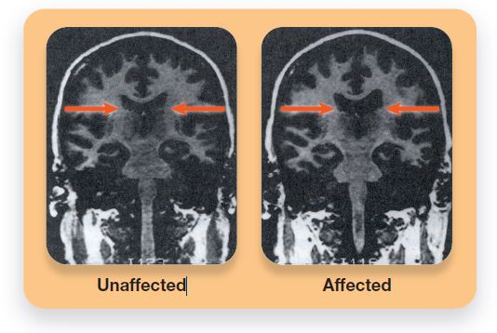
Schizophrenia and the Nervous System
Figure 15.14 Brain Volume in One Monozygotic Twin with Schizophrenia and Another without Schizophrenia
The brains of two genetically identical individuals, one affected with schizophrenia and the other unaffected, are shown here. The arrows point to the spaces created by the ventricles of the brain. Note the significant loss of brain matter in the affected individual.
Courtesy of E. Fuller Torrey and Daniel Weinberger
Notes:
1) One very noticeable difference between individuals with schizophrenia and individuals without schizophrenia is apparent in the size of the brain ventricles.
i) This is the fluid-filled spaces occurring within the core of the brain.
ii) People with schizophrenia have ventricular spaces that are 20% to 30% larger (Figure 15.14).
a) These larger spaces correspond to a loss of brain matter.
iii) The volume of the entire brain is reduced by roughly 2% in those with schizophrenia.
a) The reduced volume can be seen in structures such as the amygdala and hippocampus.
b) These anatomical changes do not cause schizophrenia; they just tend to occur in people with the disorder.
2) The brains of those with schizophrenia also appear to operate differently.
i) They tend to have a lower level of activity in their frontal lobes.
a) Those with a long history of the illness show decreased activity when they are at a resting state or when their frontal lobes are activated by cognitive tasks.
b) This includes decreased activity in the amygdala and hippocampal regions.
3) Neurotransmitters also play a role in schizophrenia.
i) Individuals with schizophrenia have overactive receptors for the neurotransmitter dopamine.
a) The excess dopamine may be involved in producing the positive symptoms (e.g., hallucinations), but not the negative symptoms (e.g., flattened affect).
ii) Glutamate appears to be underactive in brain regions, including the hippocampus and the frontal cortex.
a) Glutamate receptor activity is also inhibited by the drug PCP (angel dust), which in high doses can cause symptoms that mirror those of schizophrenia.
Long Description:
The image illustrates the intact brain volume in the unaffected and loss of brain matter in the affected individual as follows:
The image on the left shows an unaffected brain with arrows pointing to the space created by the ventricles.
The image on the right shows a schizophrenia affected brain with arrow pointing to significant loss of brain matter.

Slide 64
Working the Scientific Literacy Model: The Neurodevelopmental Hypothesis (1 of 2)
What do we know about the neurodevelopmental hypothesis?
Neurodevelopmental hypothesis (p. 600)
Growth vs. development
How can science test the neurodevelopmental hypothesis?
“Warning signs” in home videos
Schizophrenia prodrome
Notes:
1) What do we know about the neurodevelopmental hypothesis?
i) Biopsychosocial factors begin to influence behaviour before birth.
Neurodevelopmental hypothesis (p. 600) suggests that the adult manifestation of what we call “schizophrenia” is the outgrowth of disrupted neurological development early in the person’s life.
ii) This hypothesis says that the brain grows into a schizophrenic state rather than degenerating into one, such as in the neurodegenerative hypothesis.
2) How can science test the neurodevelopmental hypothesis?
i) The developmental emphasis of the hypothesis gains strength from behavioural evidence collected during childhood and adolescence.
a) For example, psychologists noticed “warning signs” in the home videos of those who developed schizophrenia.
b) As infants and children, these individuals showed unusual motor patterns primarily on the left side of the body, such as jerky, repeated, and unnecessary arm movements.
c) Siblings who did not have schizophrenia did not show these motor patterns.
ii) In adolescence, psychologists can detect the schizophrenia prodrome, a collection of characteristics that resemble mild forms of schizophrenia symptoms.
a) A teenager may become increasingly socially withdrawn and have some difficulty with depression and anxiety.
b) The most telling and perplexing problem involves hallucinations and delusions, but the person does not fully believe them.
c) For example, a teen might say, “I seem to keep hearing my mother calling my name before I fall asleep, even when I know she isn’t home. It is strange …”

Slide 65
Working the Scientific Literacy Model: The Neurodevelopmental Hypothesis (2 of 2)
Can we critically evaluate this information?
Growth spurts in the prefrontal cortex
Excessive synaptic pruning
Why is this relevant?
Alter progression of disease
Notes:
1) Can we critically evaluate this information?
i) Why are these two specific periods of development—the first trimester of gestation (pregnancy) and adolescence—linked with development of schizophrenia?
a) It turns out that both of these periods are associated with growth spurts for the prefrontal cortex, the regions of the frontal lobe involved with higher cognitive functions such as decision making, attentional control, and problem solving.
b) During the first trimester of fetal development, the fetal brain grows at an astonishing rate as new cells are born and different sections of the brain, such as the brainstem and midbrain, begin to develop. By the eighth week of development, the group of neurons that will eventually be the prefrontal cortex have developed. Animal-based research has shown that maternal infections during the first trimester lead to smaller cortical surface areas in this region.
c) During adolescence, the frontal lobes go through another important change. In addition to growing in volume, the frontal lobes also lose a large number of synapses. In adolescents who will develop schizophrenia, too much synaptic pruning occurs. Thus, they have fewer connections between neurons, which leads to a smaller and less powerful prefrontal cortex.
2) Why is this relevant?
i) By identifying prenatal risk factors and developmental patterns related to schizophrenia, it may be possible to alter the progression of the disorder.
a) As part of this process, researchers will need to improve our understanding of the types of emotional support pregnant women need in order to reduce the effects of stress hormones on the fetus.
b) A long-term goal of these related research programs would be to prevent schizophrenia from developing, or at least to control its severity. To accomplish these goals, researchers will have to rely on all levels of explanation: genetics, prenatal influences, brain structure and function, and psychosocial factors.

Slide 66
Environmental Influences on Schizophrenia
Environmental and Prenatal Factors
Maternal exposure to influenza virus
Fetal exposure to stress
Marijuana use
Head injuries
Urban environment
Notes:
Environmental and Prenatal Factors
1) Psychologists speculate that perhaps maternal exposure to the influenza virus and fetal exposure to stress hormones may put a person at risk for schizophrenia.
i) People with schizophrenia are statistically more likely to have been born during winter months.
a) The brain develops a great deal during the second trimester, which coincides with flu season.
ii) Extreme stress, such as loss of a spouse or exposure to war during pregnancy may increase chances the infant will develop schizophrenia.
2) Certain events can increase the risk of developing schizophrenia.
i) For example, a very small proportion of people who use marijuana develop psychotic symptoms, possibly because the drug interacts with the genes involved in schizophrenia.
ii) Head injuries occurring prior to age 10 also put people who are genetically vulnerable to schizophrenia at greater risk for developing the disorder.
3) Being raised in an urban environment, where psychosocial stressors are more abundant, puts individuals at greater risk for developing schizophrenia.
i) This includes poverty, unemployment, discrimination, divorce, and death of a loved one.

Slide 67
Cultural Influences on Schizophrenia
Anglo-Americans
Mental experiences
Mexican Americans
Effects on body
Swahili of Tanzania
Spirit invasion of the body
Notes:
1) There are cultural differences in how schizophrenia is perceived.
i) Anglo-Americans tend to focus on the mental experiences of the disorder, such as disorganized thinking and emotions.
a) They tend to view mental disorders as separate from other types of illness.
ii) Mexican Americans focus more on how schizophrenia affects the body, such as by producing tension or tiredness.
a) They conceive of the disorder as another other form of illness.
iii) What we believe is schizophrenia, the Swahili of Tanzania see as a sign that spirits have invaded the body.

Slide 68
Vulnerabilities and Protective Factors for Mental Disorders
Risk Factors
Academic failure
Birth complications
Caring for those who are chronically ill or who have a neurocognitive disorder
Child abuse and neglect
Chronic insomnia
Chronic pain
Family disorganization or conflict
Low birth weight
Low socioeconomic status
Medical illness
Neurochemical imbalance
Parental mental illness
Parental substance abuse
Personal loss and bereavement
Poor work skills and habits
Reading disabilities
Sensory disabilities
Social incompetence
Stressful life events
Substance abuse
Trauma experiences
Protective Factors
Aerobic exercise
Community offering empowerment, opportunity, and security
Economic independence
Effective parenting
Feelings of mastery and control
Feelings of security
Literacy
Positive attachment and early bonding
Positive parent-child relationships
Problem-solving skills
Resilient coping with stress and adversity
Self-esteem
Social and work skills
Social support from family and friends
Adequate sleep
^{I Thess 5: 16} Rejoice always, ¹⁷ pray continually, ¹⁸ give thanks in all circumstances; for this is God’s will for you in Christ Jesus.
Religious involvement
Notes:
Ted Talk: How to Make Stress Your Friend (14:28) Psychologist Kelly McGonigal explores the idea that stress can be positive if we can learn to think about it in a new way. http://www.ted.com/talks/kelly_mcgonigal_how_to_make_stress_your_friend
Ted Talk: Resilience (12:55) In his research for NASA, clinical psychologist Raphael Rose discovered that failure is key to creating resilience. He explains how leaning into trials and setbacks builds the emotional callouses that help us value what's good in life. https://www.ted.com/talks/raphael_rose_from_stress_to_resilience
MEDS Acronym

